Slide 1
Magazine moment
2021

Slide 2
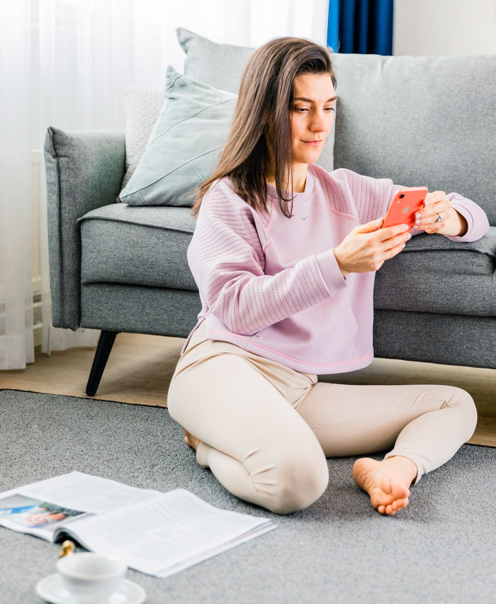

The implementation of the survey and the respondents
The data for this study was collected by means of an online panel conducted by Taloustutkimus during the period 17–25 May 2021.
A total of 1,166 people responded to the survey.
Women n = 590
Men n = 575
Other n = 0
15–24 years n = 160
25–34 years n = 157
35–44 years n = 170
45–54 years n = 175
55–64 years n = 167
65–69 years n = 167
70+ years n = 170

Slide 3
The survey respondents included both subscribers and single-copy buyers
84% of the respondents were subscribers, i.e. they have a subscription to at least one magazine.
29% of the respondents buy single copies of magazines.
What kind of a reader are you? | n = 1,166
%

Slide 4
Contents
01
Reading habits
05
Media consumption in different situations and concurrent consumption of multiple types of media
02
Readership of different types of magazines and digital content
06
Media & emotions
03
Value received for the time spent on content
07
Advertising
04
Suitability of media for following different topics
08
Summary

Slide 5
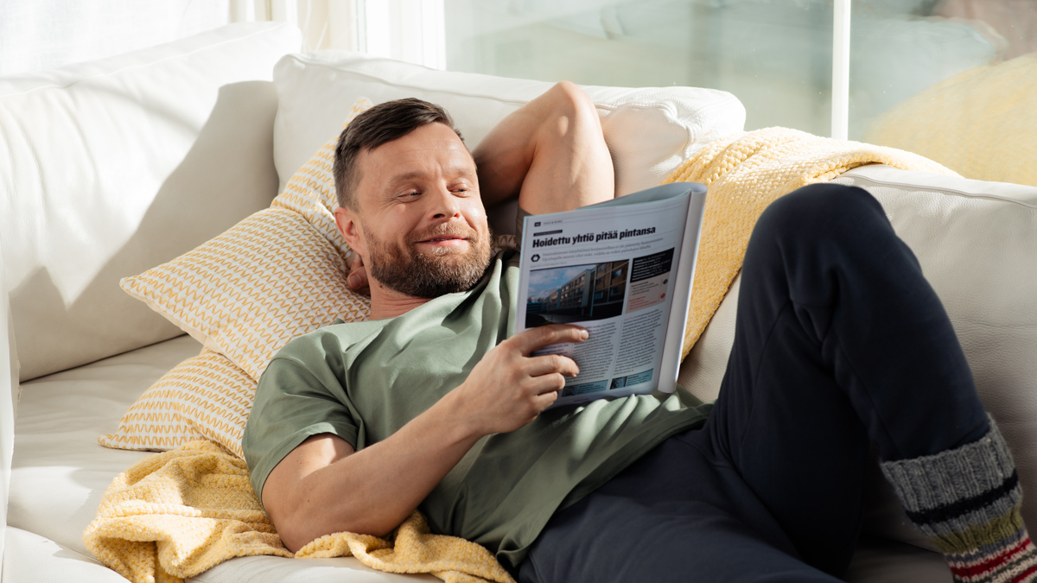
Reading habits

Slide 6
63% read magazines at least on a weekly basis,
94% at least on a monthly basis
How often do you read magazines? | n = 1,166

Slide 7
The average duration of a reading session is
26 minutes
How long do you typically spend on reading magazines in a single session? | n = 1,166

Slide 8
65% read their magazines in their entirety always or often
I read the magazines I subscribe to, or buy single copies of, in their entirety | n = 1,166

Slide 9
People read magazines in the evening when they can set aside time for it
People mostly read print magazines in the afternoon or evening.
When do you typically read the magazine of your choice? | n = 1,166
%

Slide 10
Magazine reading in the morning is the most common among young people, while people who are in the busy years of family life mostly read in the evening
When do you typically read the magazine of your choice? | n = 1,166

Slide 11
Reasons for why evenings are the preferred time to read: people read magazines to recover from the day’s work and household chores
“Helps me relax at the end of the day”
– woman, 19
“I like to rest after work by reading a magazine.”
–woman, 22
“I like to relax in the evening when the day’s work is done. It also gives me the chance to plan what to cook in the following days”
– woman, 35
“It’s a good time to relax at the end of the workday.”
– man, 50
“In the evening when the day’s work and chores are done, you can relax with a magazine with a clear conscience.”
– man, 65

Slide 12
Reasons for why evenings are the preferred time to read: in the evening, people have the opportunity to focus on reading
“I don’t have the time to focus properly at other times of the day and I like to really get engrossed in a magazine”
– man, 39
“That’s when I have time to relax and focus on the things I enjoy”
– woman, 54
“If I buy a magazine at the supermarket, I read it when I get home in the afternoon or save it for the evening when I have time to spare.”
– woman, 64
“There are no distractions”
– man, 72
“That’s when I usually have time to read and focus on what I read”
– woman, 24
“When the kids have gone to bed, I have quiet time to spend on reading.”
– man, 45

Slide 13
Reasons for why evenings are the preferred time to read: reading a magazine is a way to calm down before going to bed
“I read in bed when I’m getting ready to sleep. It’s a quiet time when I can focus on reading and there are no other stimuli to distract me.”
– woman, 33
“I have quiet time before going to sleep. This is when my partner is already asleep or also reading.”
– man, 65
“Relaxing after the day’s chores, before sleeping.”
– man, 42
“The best time to read is just before sleeping, in bed. That’s when I can relax for a while with a magazine.”
– woman, 42
“Reading in the evening before sleeping is a nice relaxing activity.”
– woman, 22

Slide 14
People prefer to read magazines at home
People read magazines at home: in the living room, kitchen and bedroom.
Women are more likely than men to read on their terrace, while men are more likely to read in the bathroom.
Where do you usually read the magazine of your choice? | n = 1,166
%
Notes:
See the comparison here.

Slide 15
Weekdays and weekends are not defining factors for reading a magazine – people like to have magazine moments at both times
Do you read on weekdays or weekends? | n = 1,166

Slide 16
In the choice of when to read, what’s more important than the day of the week is being able to allocate time to reading
– nevertheless, among young age groups, slightly less than half of the respondents prefer reading either on weekdays or weekends
Do you read on weekdays or weekends? | n = 1,166

Slide 17
Nearly 1/3 of the respondents read more when they are on holiday
How do holiday periods affect reading? | n = 1,166

Slide 18
Women and young people, in particular, read more when they are on holiday
How do holiday periods affect reading? | n = 1,166

Slide 19
Which statement better describes the way you read the magazine of your choice?
“I usually pick up a magazine when I’m not in a hurry to go anywhere. When you’re busy, you can’t focus on a magazine.”
– woman, 45
n = 1,166

Slide 20
Focusing on a magazine is high in all age groups – young people are more likely to multitask while reading
Which statement better describes the way you read the magazine of your choice? | n = 1,166

Slide 21
Pensioners are more likely to read a magazine as soon as it comes out – people in other age groups wait for the right moment
Which statement better describes the way you read the magazine of your choice? | n = 1,166

Slide 22
Magazines are typically read more than once
Which statement better describes the way you read the magazine of your choice? | n = 1,166

Slide 23
The life of a magazine continues after it has been read – 82% of the respondents keep their magazines or pass them on to others
After I have finished reading my favourite magazine… | n = 1,166
%

Slide 24
How do you keep interesting content from your favourite magazine? (e.g. a full article, a picture or product information in an advertisement)
In the 24–35 age group, one in two respondents use their phone to take photos of interesting content in a magazine.
Women are more likely to take photos of magazine content than men.
n = 1,166
Notes:
Retrieve comparison data

Slide 25
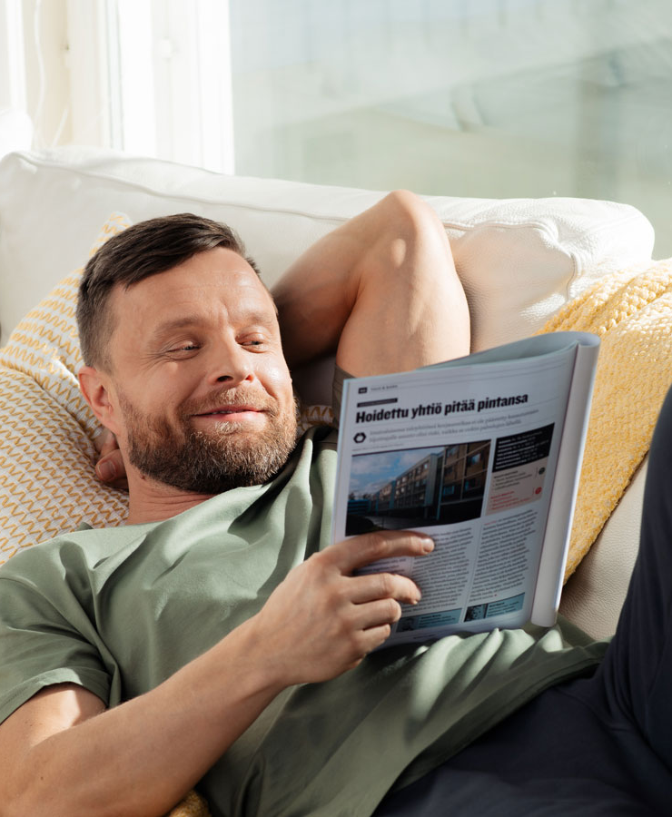
Reading habits
94% of the respondents read magazines at least on a monthly basis.
Reading magazines on a daily basis is particularly common among men, young people (15–24 age group) and people over 70 years of age.
People spend an average of 26 minutes on reading a magazine in one reading session.
Approximately 2/3 of the respondents read magazines they subscribe to or buy single copies of always or frequently.
People mostly read print magazines in the afternoon or evening.

Slide 26
Reading habits
People read magazines at home.
Most of the respondents have time for magazine moments on both weekdays and weekends.
They focus on reading their magazine and read when they have enough time for it.
82% of the respondents either keep their magazines after reading them or pass them on to others.
Young adults, in particular, take photos of interesting content they find in magazines.

Slide 27
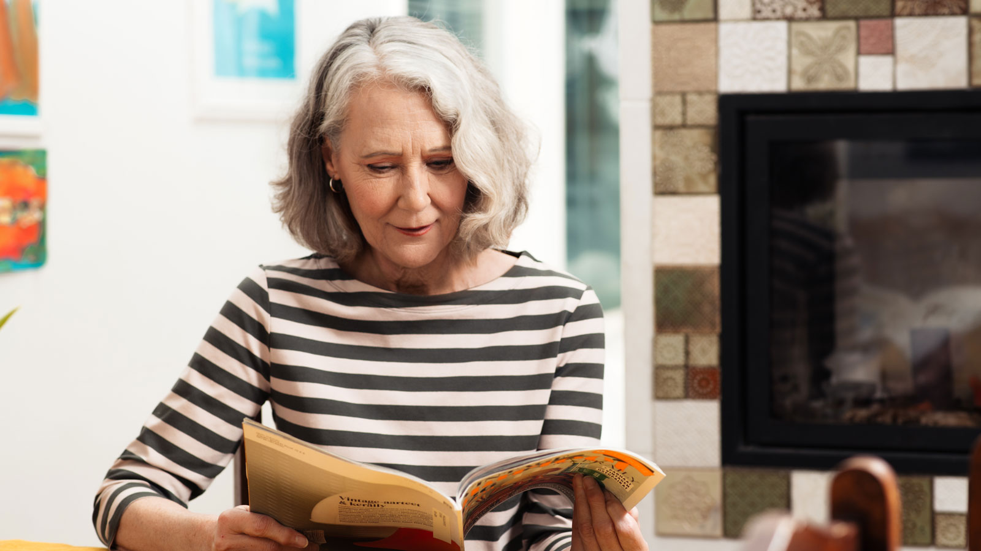
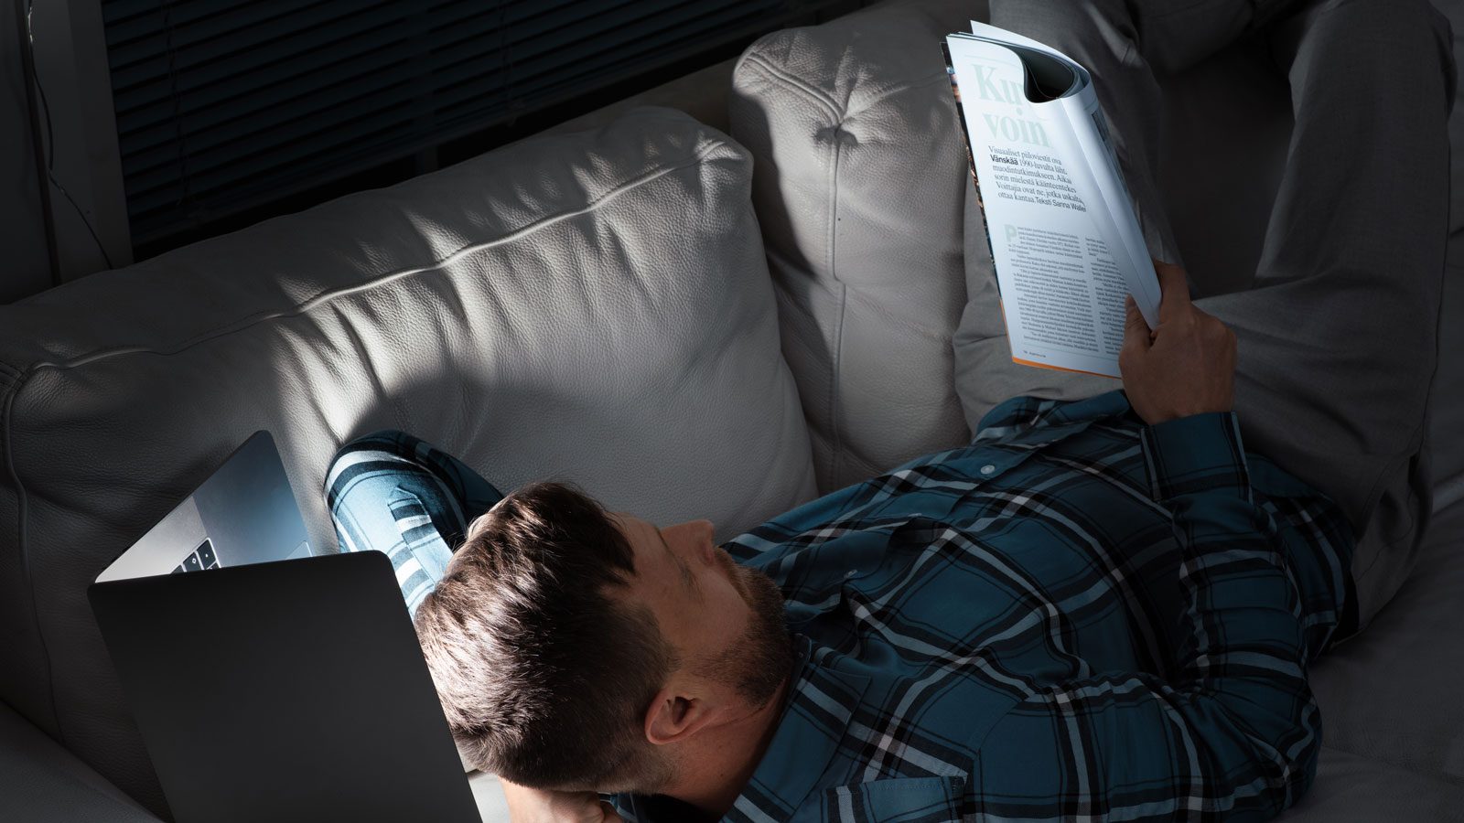
Readership of different types of magazines

Slide 28
Regular readership of different types of magazines
1/2
Customer magazines have the highest readership among different magazine types.
They are read regularly by people in all age groups.
Which of the following types of magazines do you read regularly? | n = 1,166

Slide 29
Regular readership of different types of magazines
2/2
Top 5 magazine types read regularly by women
Customer magazines
Women’s magazines
Home and gardening magazines
Magazines on well-being, beauty and health
Magazines published by non-profit organisations
Top 5 magazine types read regularly by men
Customer magazines
Magazines on news, current affairs, business and finance
Technical and hi-fi magazines
Science magazines
Car and motor vehicle magazines
Which of the following types of magazines do you read regularly? | n = 1,166

Slide 30
The respondents’ favourites among magazines that they read regularly are women’s magazines and magazines on news, current affairs, business and finance
23% of the female respondents said their favourite magazine is a women’s magazine.
18% of the male respondents
specified a magazine on news, current affairs, business and finance as their favourite magazine.
What is your favourite Finnish magazine that you read regularly?
| n = 1,070
Presented as an open question and the magazine groups were subsequently coded from the responses.

Slide 31
56% of magazine readers also read magazine content in digital format
Do you read magazine content in digital format? | n=1,166
%

Slide 32
Reasons for not reading magazine content in digital format: prefer to read print magazines, not interested in digital content, want to avoid looking at screens
Among the respondents who do not read magazine content in digital format, n = 512

Slide 33
Reasons for not reading magazine content in digital format: the reading experience is compared to reading print magazines – compared to digital formats, the concrete magazine feels nice and manageable
Among the respondents who do not read magazine content in digital format, n = 512
“I can browse the magazine, leave it open and pick it up later. When you have a stack of magazines on a table, you can choose which one you want to read at any given time. A physical magazine allows you to focus on reading without having to fiddle with a digital device.”
– man, 72
“I like browsing a magazine. You tend to notice sections that you might miss if you read the digital version.”
– woman, 63
“I enjoy reading a physical magazine. I like having something concrete in my hand, and looking at the pictures is also nicer when you read the print version.”
– woman, 15
“I want to read and hold a physical magazine, to browse it and go back to the beginning when I want to. It’s easier to handle than a digital device, especially if you’re lying down on your sofa.”
– woman, 67
“The mobile views of an article are often small and I prefer traditional print magazines.”
– woman, 25
“It’s impractical. I want to read and scan the entire article, not just the small part that fits the screen of a smart device. Sometimes I’ll look for an old article in the digital version if I unexpectedly want to show it to a friend.”
– woman, 29

Slide 34
Reasons for not reading magazines in digital format: consumption of digital media is high anyway, print media provides variation and the ability to limit the reading session
Among the respondents who do not read magazine content in digital format, n = 512
“Life is already full of digital content. I don’t want any more of it if I have other options”
– man, 37
“I spend enough time looking at screens as it is, with the world today being so digital (work, banking, etc.). I enjoy the feel of a print magazine and the variation it offers to looking at screens.”
– man, 42
“I read newspapers in digital format and that’s enough for me. A magazine is a thing in itself, like a book. You don’t just browse it or scan it, like you might when it comes to the day’s news headlines. When you read a magazine, you take your time and solve a crossword puzzle, for example.”
– woman, 68
“At work I spend eight hours a day sitting in front of a screen. I want to rest my eyes at lunch and in the evening. The concrete print edition is kinder on your eyes (the adverse impact of blue light) and when you read content printed on paper, the muscles of the eye get to move more than when you read content on a narrow digital device.”
– woman, 32

Slide 35
Reasons for not reading magazines in digital format: the print magazine is easier to focus on
Among the respondents who do not read magazine content in digital format, n = 512
“When you use a phone, you spent time reading various discussion forums and such instead of magazines”
– woman, 31
“Digital media increases your stress levels, paper magazines reduce them.”
– woman, 63
“Reading a digital magazine doesn’t feel natural. It’s difficult to focus on digital content.”
– man, 31
“I find it easier to focus on reading a magazine in paper format. If I read a magazine in digital format, I tend to do something else online instead of reading the magazine.”
– woman, 38
“When you read, you focus (you need to focus and you can focus) much more than when you watch TV, listen to the radio or use a mobile phone.”
– woman, 45

Slide 36
Reading digital magazine content differs from the reading experience of a print magazine particularly in terms of being current and easily accessible
In your opinion, how is reading digital magazine content different from reading a print magazine? | Among those who also read magazine content in digital format, n = 654

Slide 37
How is reading digital content different from reading a print magazine: digital is easily accessible
Among those who also read magazine content in digital format, n = 654
“In the digital edition you can find just about anything depending on what you feel like reading about”
– woman, 44
“Digital content is always with you and it doesn’t take up extra space.”
– woman, 26
“The digital content is always with you, even when you’re not at home. The paper version is more pleasant to read and it’s faster to find the sections you’re looking for.”
– man, 49
“The digital magazine is always with you in your mobile device, as are the magazine’s archives, which makes it easy to go back to an interesting story. I have the full annual volumes of certain magazines on my shelf. Nevertheless, if I need to read something in a previous edition, I tend to use the digital archive because it’s easy to use and finding the story you’re looking for is faster as long as the digital archive extends back to the period in question.”
– man, 59
“Digital versions are nice to read on the screen of my mobile phone; for example, at night when I’m tucked under the blanket.”
– woman, 32
“It’s easier to carry your phone with you and read when you’re out in public”
– woman, 18

Slide 38
How is reading digital content different from reading a print magazine: digital content is read one article at a time, whereas print readers read the entire magazine
Among those who also read magazine content in digital format, n = 654
“Reading articles in digital format is OK, but I don’t want to read an entire magazine on my phone, for example. I value the print version more highly (and the same goes for books).”
– woman, 42
“When you read a print magazine, you get a curated whole. When you read a digital magazine, you read individual articles.”
– man, 38
“When you read the digital version, you browse the headlines rather than read the articles themselves. When you read the print version, you read it in order, one article at a time”
– woman, 54
“When you read a digital magazine, you tend to just browse the headlines. When you read the print version, you are more likely to read the full article”
– woman, 20
“I’m more picky about choosing which articles to read in a digital magazine. When I read a print magazine, I almost always read most of the articles.”
– man, 27
“I only read a few articles. I’m more picky. I might not finish an article I start reading. Reading digital content feels more rushed and superficial”
– woman, 38

Slide 39
Print magazines compare favourably to the digital reading experience especially when it comes to the richness of the experience and the feel
In your opinion, how is reading digital magazine content different from reading a print magazine?
Among those who read magazine content in digital format, n = 654

Slide 40
How is reading digital content different from reading a print magazine: richness of the experience, the feel
Among those who also read magazine content in digital format, n = 654
“I enjoy the feel of a magazine and even the way it smells. Browsing a physical magazine is nicer than browsing a digital edition.”
– woman, 65
“When I read a print magazine, I like scanning the entire page and read all the little captions. I like the feel of a physical magazine. You just don’t get that same feeling when you read the digital version. I often stop reading in the middle of an article when some notification or other stimulus pops up.”
– woman, 23
“The print magazine has a better feel. I appreciate the visual layout and the way it feels in your hand.”
– woman, 27
“Reading a digital version feels more distant. Reading a paper version feels more personal and the magazine is easier to handle.”
– man, 55
“Bringing it out and browsing it is not as appealing because you don’t see it lying around and the reading never happens half accidentally, as is the case with a print magazine. Then again, the digital version is convenient to access when you’re not at home and you need to wait for something.”
– man, 65
“When you stare at your phone and read something online, it lacks the richness of experience. You can genuinely relax when you read a paper magazine on your sofa or out on your lawn and you’re not always holding your phone.”
– woman, 24

Slide 41
Readership of different types of magazines
Customer magazines have the highest readership among different magazine types.
The respondents’ favourite Finnish magazines are women’s magazines and magazines on news, current affairs, business and finance.
56% of magazine readers also read magazine content in digital format.
Print magazines are considered to be more rich in experience, whereas digital magazines are considered to be more current and always accessible. Digital archives and search functions are also appreciated.

Slide 42

Value received for the time spent on content

Slide 43
73% of the respondents feel that they get good value for their time always or often when they read print magazine content
I feel that I get good value for my time when I read print magazine content… | n = 1,166

Slide 44
39% of the respondents feel that they get good value for their time always or often when they read digital media content – satisfaction rates are the highest among young age groups and men
I feel that I get good value for my time when I read digital media content… | n = 1,166

Slide 45
Value received for the time spent on content
73% of the respondents feel that they get good value for their time spent with a print magazine. Only 3% say they get good value for their time only rarely (0% never).
39% of the respondents feel that they get good value for their time spent with digital media. Satisfaction with digital content is higher among young people than in older age groups.

Slide 46
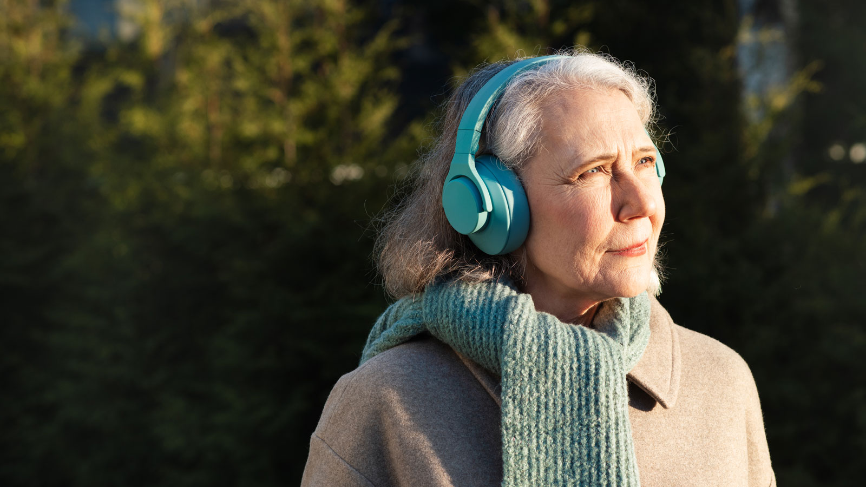
Suitability of media for following different topics

Slide 47
Suitability of media for following different topics
Cars and motor vehicles
Respondents interested in this topic are more likely than average to read technical and hi-fi magazines as well as car and motor vehicle magazines.
In your opinion, which media are especially well suited to following these topics?
| n=1,166

Slide 48
Suitability of media for following different topics Electronics and information technology
Respondents interested in this topic are more likely than average to read technical and hi-fi magazines,
science magazines and
computer and gaming magazines.
In your opinion, which media are especially well suited to following these topics?
| n=1,166

Slide 49
Suitability of media for following different topicsCosmetics and beauty
Respondents interested in this topic are more likely than average to read well-being, beauty and health magazines, women’s magazines and food and drink magazines.
In your opinion, which media are especially well suited to following these topics?
| n=1,166

Slide 50
Suitability of media for following different topics
Travel
The respondents interested in this topic read a rather broad range of various magazines.
The types of magazines that are read more frequently than average include customer magazines, women’s magazines, travel magazines, home and gardening magazines, food and drink magazines and magazines on news, current affairs, business and finance.
In your opinion, which media are especially well suited to following these topics?
| n=1,166

Slide 51
Suitability of media for following different topics
Fashion
Respondents interested in this topic are more likely than average to read women’s magazines and home and gardening magazines, for example.
In your opinion, which media are especially well suited to following these topics?
| n=1,166

Slide 52
Suitability of media for following different topics
Renovation and construction
Respondents interested in this topic are more likely than average to read magazines published by non-profit organisations as well as home and gardening magazines.
In your opinion, which media are especially well suited to following these topics?
| n=1,166

Slide 53
Suitability of media for following different topics
Food and cooking
Respondents interested in this topic are more likely than average to read customer magazines, women’s magazines, home and gardening magazines, food and drink magazines as well as well-being, beauty and health magazines.
In your opinion, which media are especially well suited to following these topics?
| n=1,166

Slide 54
Suitability of media for following different topics
Interior design
Respondents interested in this topic are more likely than average to read customer magazines, women’s magazines as well as home and gardening magazines.
In your opinion, which media are especially well suited to following these topics?
| n=1,166

Slide 55
Suitability of media for following different topics
Saving and investing
Respondents interested in this topic are more likely than average to read customer magazines, magazines on news, current affairs, business and finance as well as technical and hi-fi magazines.
In your opinion, which media are especially well suited to following these topics?
| n=1,166

Slide 56
Suitability of media for following different topics
Health and well-being
Respondents interested in this topic are more likely than average to read customer magazines, women’s magazines, home and gardening magazines as well as well-being, beauty and health magazines.
In your opinion, which media are especially well suited to following these topics?
| n=1,166

Slide 57
Suitability of media for following different topics
Sports
Respondents interested in this topic are more likely than average to read magazines on news, current affairs, business and finance as well as well-being, beauty and health magazines and technical and hi-fi magazines.
In your opinion, which media are especially well suited to following these topics?
| n=1,166

Slide 58
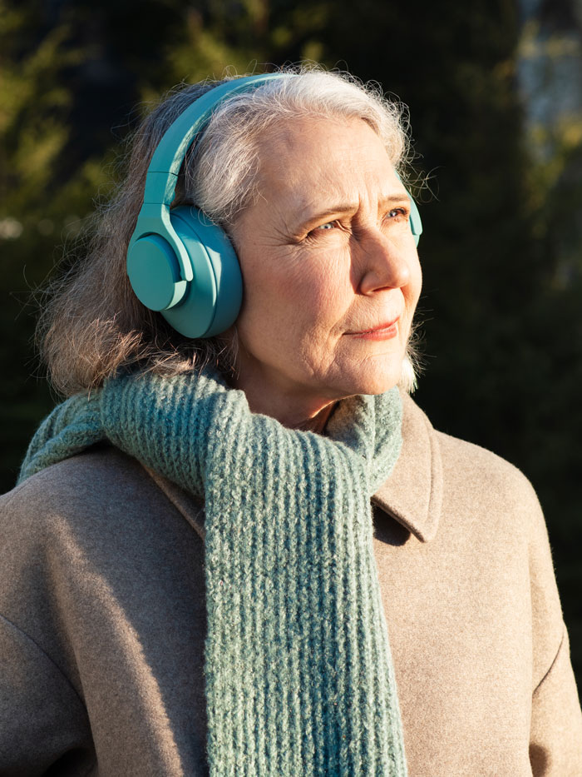
Suitability of media for following different topics
Print magazines are very well suited for following most topics.
Media that are suitable for young people include digital media and social media in all topic categories.
The combination of print magazine + online edition increases magazines’ suitability to following various topics.

Slide 59
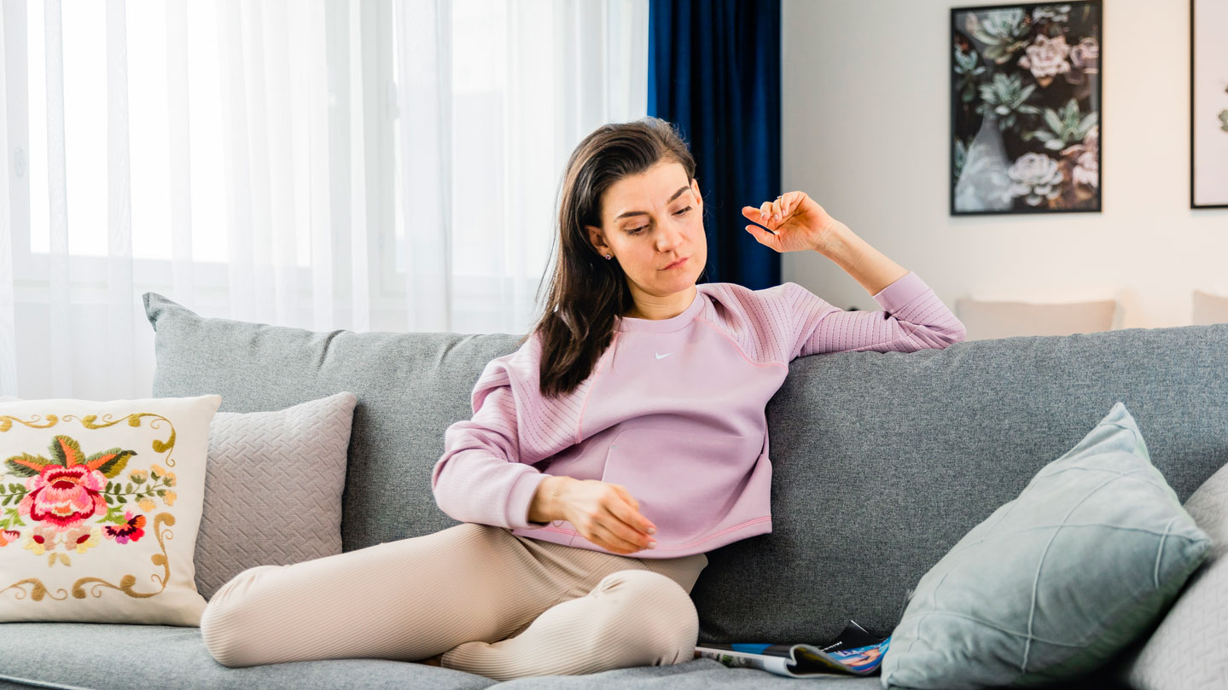
Media consumption in different situations

Slide 60
People choose print magazines when they want to relax and take their time with a topic – they choose digital media when they want to pass the time and be entertained
Which type of media do you choose in the following situations? | n = 1,166

Slide 61
The concurrent consumption of different types of media is not common in the context of print media
In what types of media consumption moments do you typically use some other type of media at the same time? n = uses the media in question

Slide 62
In what types of media consumption moments do you typically use some other type of media at the same time? When reading a magazine
This question was only asked of those who consume this type of media

Slide 63
In what types of media consumption moments do you typically use some other type of media at the same time? When reading a newspaper
This question was only asked of those who consume this type of media

Slide 64
In what types of media consumption moments do you typically use some other type of media at the same time? When listening to the radio
This question was only asked of those who consume this type of media

Slide 65
In what types of media consumption moments do you typically use some other type of media at the same time? When watching TV
This question was only asked of those who consume this type of media

Slide 66
In what types of media consumption moments do you typically use some other type of media at the same time? When browsing an online newspaper, online magazine or other online media
This question was only asked of those who consume this type of media

Slide 67
In what types of media consumption moments do you typically use some other type of media at the same time?
When using social media (e.g. Facebook, Instagram)
This question was only asked of those who consume this type of media

Slide 68
In what types of media consumption moments do you typically use some other type of media at the same time? When reading a blog
This question was only asked of those who consume this type of media

Slide 69
In what types of media consumption moments do you typically use some other type of media at the same time? When watching YouTube or other video streaming services
This question was only asked of those who consume this type of media

Slide 70
In what types of media consumption moments do you typically use some other type of media at the same time? When listening to a podcast
This question was only asked of those who consume this type of media

Slide 71
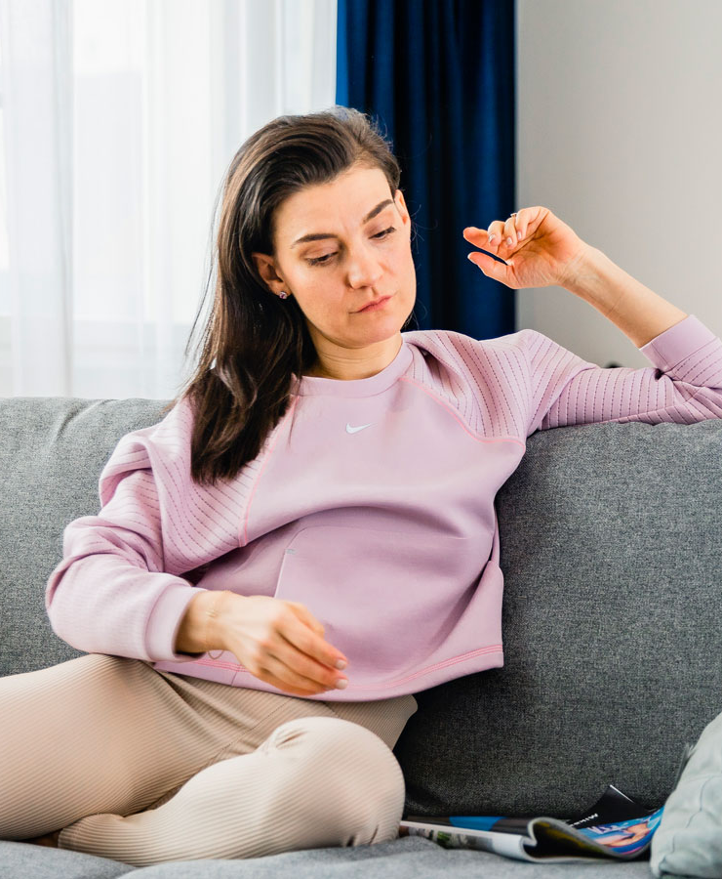
Media consumption in different situations
People read magazines when they want to relax, have some “me time” or get engrossed in particularly important and interesting content.
Digital media is consumed particularly in situations where people are passing time, want to learn something new or are travelling from Point A to Point B.
The concurrent use of other media is the most common in the context of listening to the radio or watching TV.

Slide 72
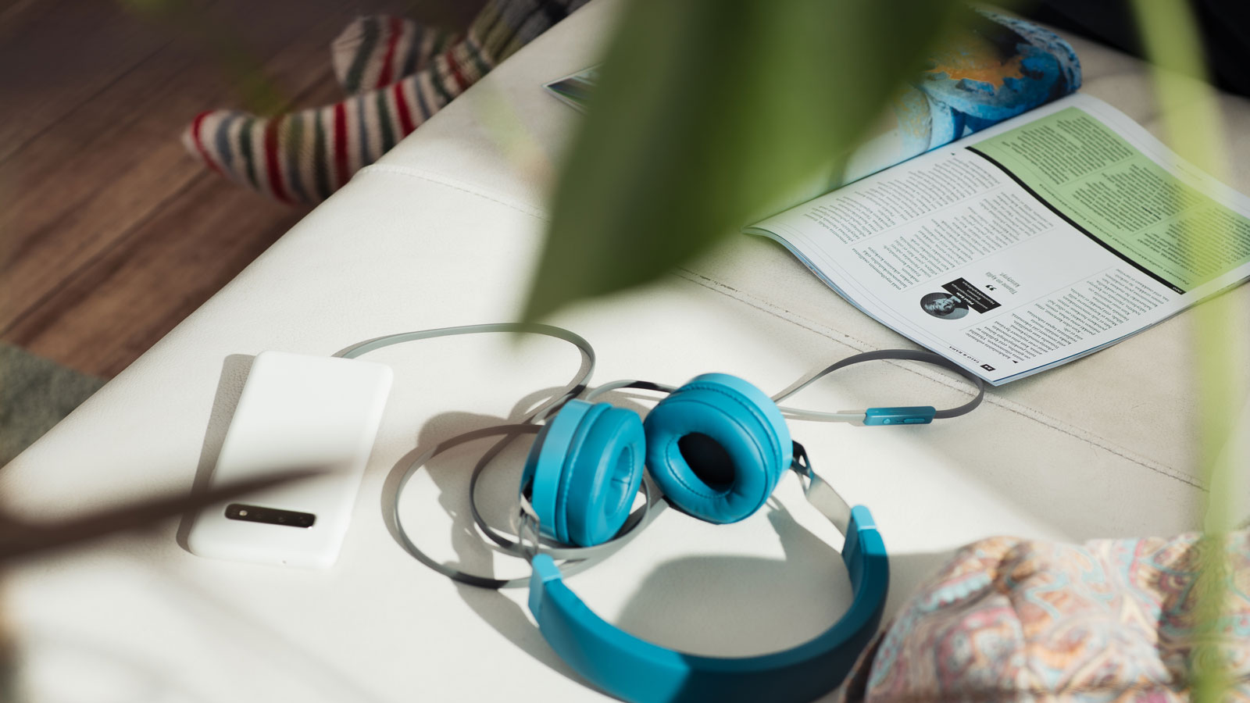
Media & emotions

Slide 73
Top 10 emotions – print magazines
Which emotion best describes the way you feel when you consume the following media? | n = 1,044

Slide 74
Where do the emotions experienced when reading a magazine emerge from? Relaxation – your own magazine = “me time”
“Taking a moment to yourself, a short break from the daily grind.”
– man, 43
“I only focus on the magazine and forget about everything else”
– woman, 37
“Reading magazines is a weekly ritual that I look forward to.”
– woman, 33
“I get to make my own choices about what articles interest me, what order I read the articles in and how much time I spend reading.”
– man, 63
“I can relax, lie in bed or sit out on the balcony, drink a cup of coffee or eat something delicious, enjoy looking at pretty pictures and read short articles on various topics”
– woman, 62
“There’s no media overload. You don’t get interrupted by phone notifications, for example”
– woman, 20
“Having a concrete magazine in your hand is a sign that you can relax and focus on reading.”
– man, 45

Slide 75
Where do the emotions experienced when reading a magazine emerge from? Inspiration – self-selected content is interesting
“I subscribe to this magazine because I’m interested in it”
– woman, 54
“Interesting articles and tips for my own life and coping with the demands of daily life.”
– woman, 42
“I learn something new, I want to invest in my personal development”
– man, 30
“The feeling that comes across from the magazine. The pictures, text and articles”
– woman, 30
“I get to take my time and read about topics that interest me.”
– man, 66
“I choose magazines that address topics that interest and inspire me (interior design, handicrafts, cooking), which means that I get inspired and relaxed when I read about them”
– woman, 23

Slide 76
Where do the emotions experienced when reading a magazine emerge from? Focus – the reading session does not begin when you’re busy
“Magazines are full of interesting articles that get my full attention and get me to focus.”
– woman, 22
“When I read a print magazine, I focus on it more and pay more attention to it. It makes it possible to have some time to yourself instead of always using your phone. It also makes it more acceptable in other people’s eyes to spend time on reading.”
– man, 42
“I’m prepared to focus on the topics featured in the magazine.”
– woman, 44
“Good and interesting articles get my full attention.”
– woman, 49
“Longer reading sessions, longer stories.”
– man, 27
“When I read, I focus on that activity. I can’t do anything else at the same time. Nor do I want to.”
– woman, 38

Slide 77
Top 10 emotions – magazine websites
Which emotion best describes the way you feel when you consume the following media? | n = 593

Slide 78
Top 10 emotions – print newspapers
Which emotion best describes the way you feel when you consume the following media? | n = 887

Slide 79
Top 10 emotions – newspaper websites
Which emotion best describes the way you feel when you consume the following media? | n = 819

Slide 80
Top 10 emotions – TV
Which emotion best describes the way you feel when you consume the following media? | n = 819

Slide 81
Top 10 emotions – radio
Which emotion best describes the way you feel when you consume the following media? | n = 931

Slide 82
Top 10 emotions – social media
Which emotion best describes the way you feel when you consume the following media? | n = 777

Slide 83
Top 10 emotions – blogs
Which emotion best describes the way you feel when you consume the following media? | n = 473

Slide 84
Top 10 emotions – YouTube
Which emotion best describes the way you feel when you consume the following media? | n = 708

Slide 85
Top 10 emotions – podcasts
Which emotion best describes the way you feel when you consume the following media? | n = 428

Slide 86
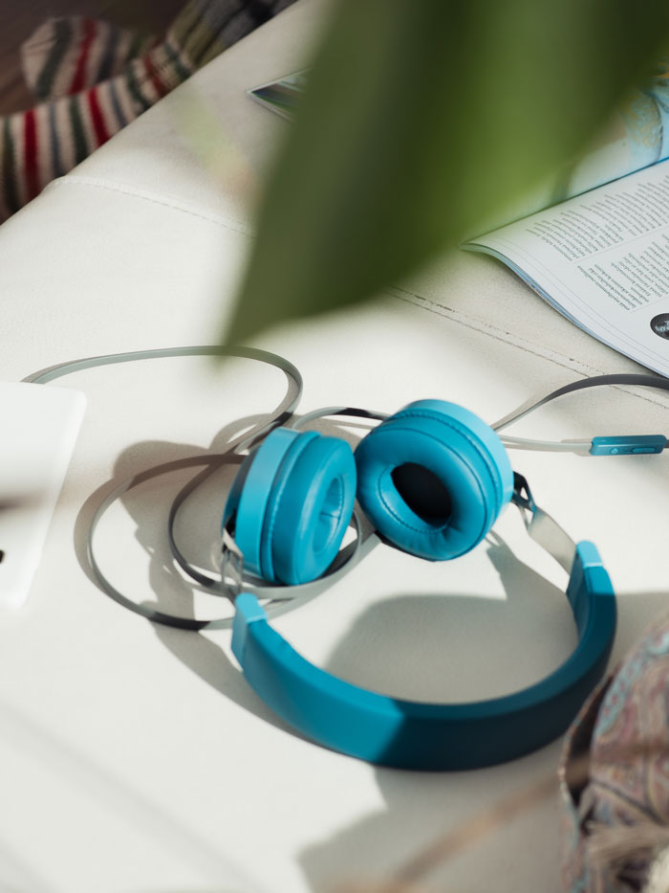
Media & emotions
There are a lot of positive emotions associated with media consumption. There are hardly any negative emotions associated with reading print magazines or listening to radio or podcasts.
The consumption of digital media – and social media in particular – involve negative emotions, even strong ones, to a greater extent.

Slide 87
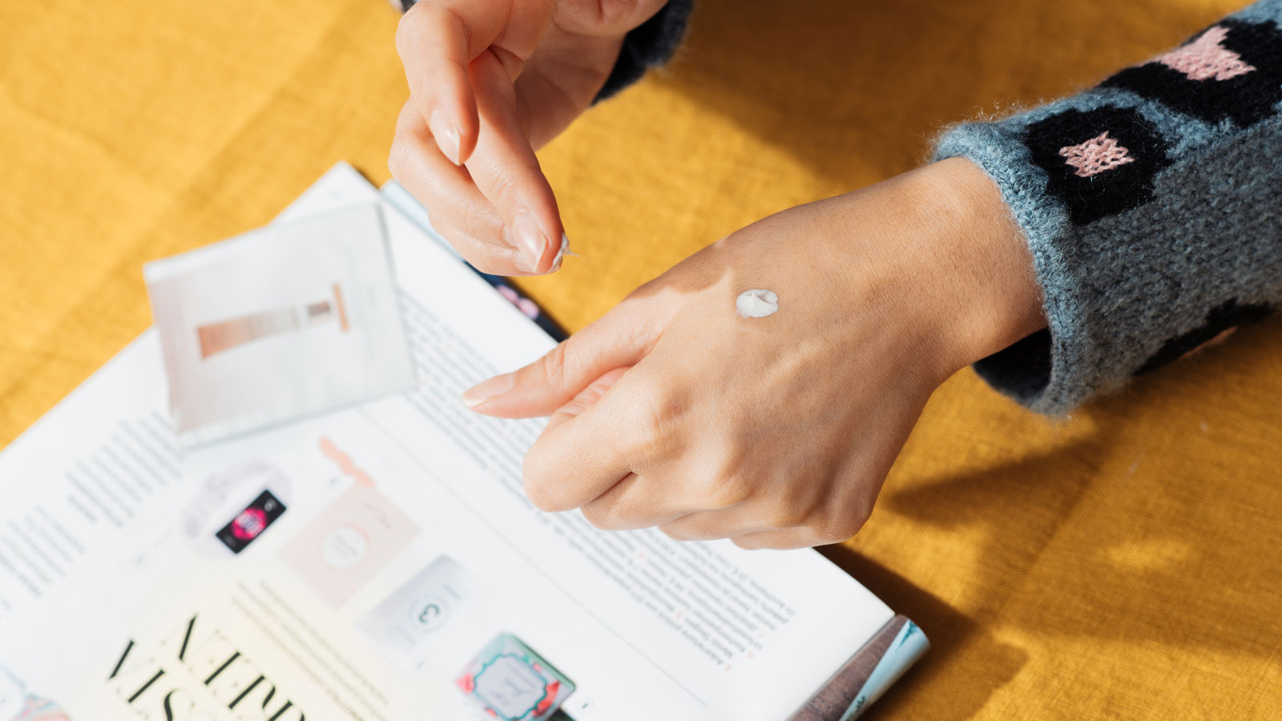
Advertising

Slide 88
Statements concerning advertising
How would you describe your attitude towards advertising in magazines? | n = 1,166

Slide 89
I want the advertised product or service to be related to the topics featured in the magazine
n = 1,166

Slide 90
Competitions and lucky draws in print advertisements attract my attention
n = 1,166

Slide 91
Competitions and lucky draws on magazine websites attract my attention
n = 1,166

Slide 92
If an advertising concerns a cosmetics product or fragrance, I want to it to include a sample for me to try
n = 1,166

Slide 93
Ideally, advertisements bring added value to the content of a magazine
n = 1,166

Slide 94
I’d be happy to participate in an advertiser’s test group on a magazine’s website
n = 1,166

Slide 95
For me, influencer marketing in blogs and social media is a preferred way to receive advertising
n = 1,166

Slide 96
Advertising
2/3 of the respondents want advertisements to be related to the topics featured in the magazine. Young readers are especially particular about this.
More than half of the respondents agree or somewhat agree with the statement that, ideally, advertisements bring added value to the content of a magazine.

Slide 97
Advertising
More than half of the female respondents want to get a product sample with a cosmetics advertisement.
65% of the young respondents feel that influencer marketing in blogs and social media is a preferred way to receive advertising

Slide 98
Summary
The emotions associated with magazine moments are positive, such as relaxation, inspiration and the thirst for knowledge.
People prefer to focus fully on their magazine moments and there is no room for the concurrent use of other media.
Magazine moments are typically spent on the sofa at home and people like to allocate sufficient time to them.
Magazines are well suited for following a wide range of topics.
More than half of the surveyed readers also consume digital magazine content.
73% of the respondents feel that they get good value for their time always or often when they read print magazine content.

