Slide 1
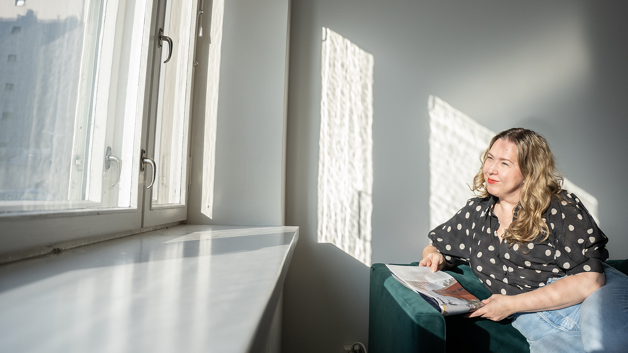

Reading times & number of readings of Finnish magazines
National Readership Survey 2026

Slide 2
Contents
01
Reading times by magazine group
02
Number of readings by magazine group
03
Longest read magazines

Slide 3
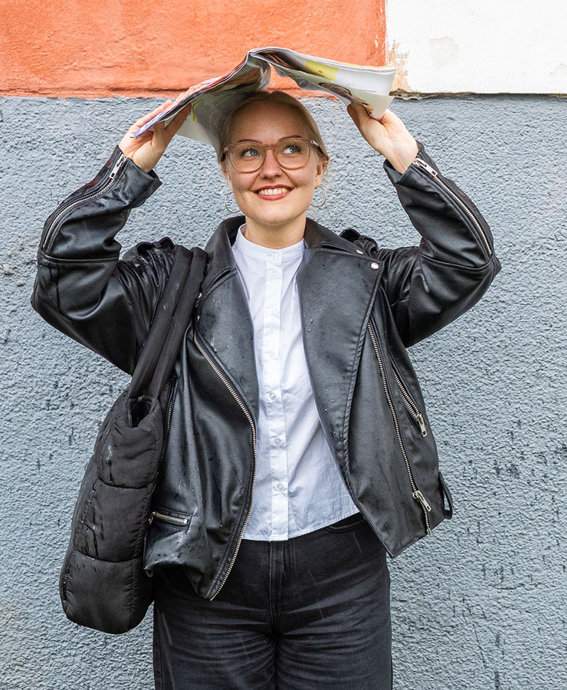
On average, 58 minutes is spent reading a magazine issue.
That is four minutes longer compared to the previous year

Slide 4
Reading times by magazine group
Average amount of time spent on one issue, averages by magazine group
Magazine group | Average reading times, NRS 2026 | Change from the previous year
General interest magazines | 1 h 28 min | + 9 min
Women's magazines | 1 h 13 min | + 5 min
Special interest magazines | 1 h 7 min | + 3 min
Health and well-being magazines | 1 h 5 min | + 6 min
Housing, construction and gardening magazines | 1 h 5 min | + 4 min
Hobby magazines | 1 h 4 min | + 4 min
Travel magazines | 1 h 3 min | + 4 min
Food and drink magazines | 1 h 3 min | + 2 min
Motoring and technical magazines | 1 h 1 min | – 1 min
Professional magazines and organisation magazines | 58 min | + 4 min
Economy and business magazines | 57 min | + 1 min
Customer magazines | 40 min | + 3 min
All magazines | 58 min | + 4 min

Slide 5
Reading times by by gender
Average amount of time spent on one issue, averages by magazine group
 | Women
General interest magazines | 1 h 32 min
Women's magazines | 1 h 16 min
Special interest magazines | 1 h 11 min
Housing, construction and gardening magazines | 1 h 10 min
Food and drink magazines | 1 h 9 min
Health and well-being magazines | 1 h 9 min
Hobby magazines | 1 h 8 min
Travel magazines | 1 h 8 min
Economy and business magazines | 57 min
Professional magazines and organisation magazines | 51 min
Motoring and technical magazines | 44 min
Customer magazines | 44 min
All magazines | 1 h 1 min
 | Men
General interest magazines | 1 h 20 min
Motoring and technical magazines | 1 h 4 min
Special interest magazines | 1 h 4 min
Hobby magazines | 1 h 3 min
Professional magazines and organisation magazines | 1 h 2 min
Economy and business magazines | 57 min
Travel magazines | 55 min
Housing, construction and gardening magazines | 52 min
Health and well-being magazines | 51 min
Women's magazines | 50 min
Food and drink magazines | 49 min
Customer magazines | 32 min
All magazines | 54 min

Slide 6
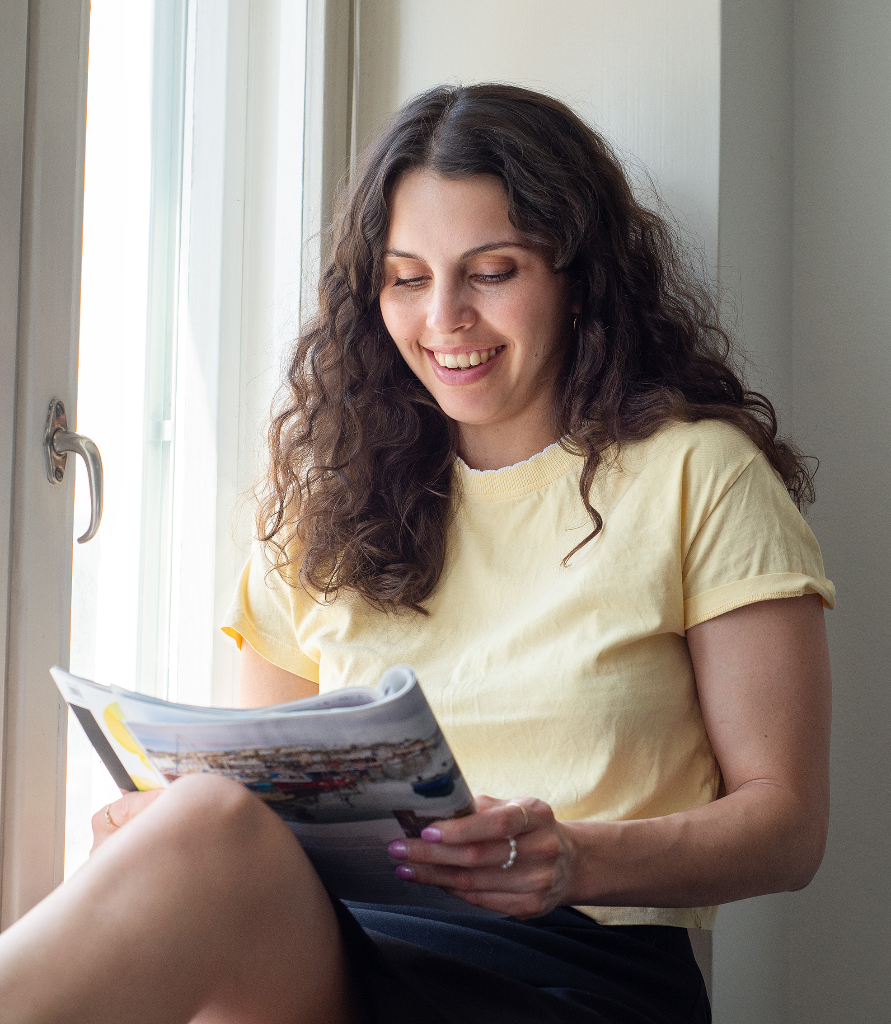

On average, people pick up a magazine issue two times.
Food and drink magazines (2.7) and hobby magazines (2.5) receive the highest number of readings.

Slide 7
Number of readings by magazine group
Average number of readings per magazine issue, average by magazine group
Magazine group | Total 15+ population, average number of readings | Women, average number of readings | Men, average number of readings
Food and drink magazines | 2.7 | 3.0 | 2.1
Hobby magazines | 2.5 | 2.8 | 2.2
General interest magazines | 2.4 | 2.4 | 2.3
Housing, construction and gardening magazines | 2.3 | 2.5 | 1.8
Special interest magazines | 2.2 | 2.4 | 2.1
Travel magazines | 2.2 | 2.5 | 1.9
Motoring and technical magazines | 2.2 | 1.8 | 2.3
Women's magazines | 2.2 | 2.3 | 1.7
Professional magazines and organisation magazines | 2.0 | 1.7 | 2.2
Economy and business magazines | 2.0 | 2.0 | 2.0
Health and well-being magazines | 1.9 | 2.0 | 1.8
Customer magazines | 1.6 | 1.7 | 1.4
All magazines | 2.0 | 2.1 | 1.9

Slide 8
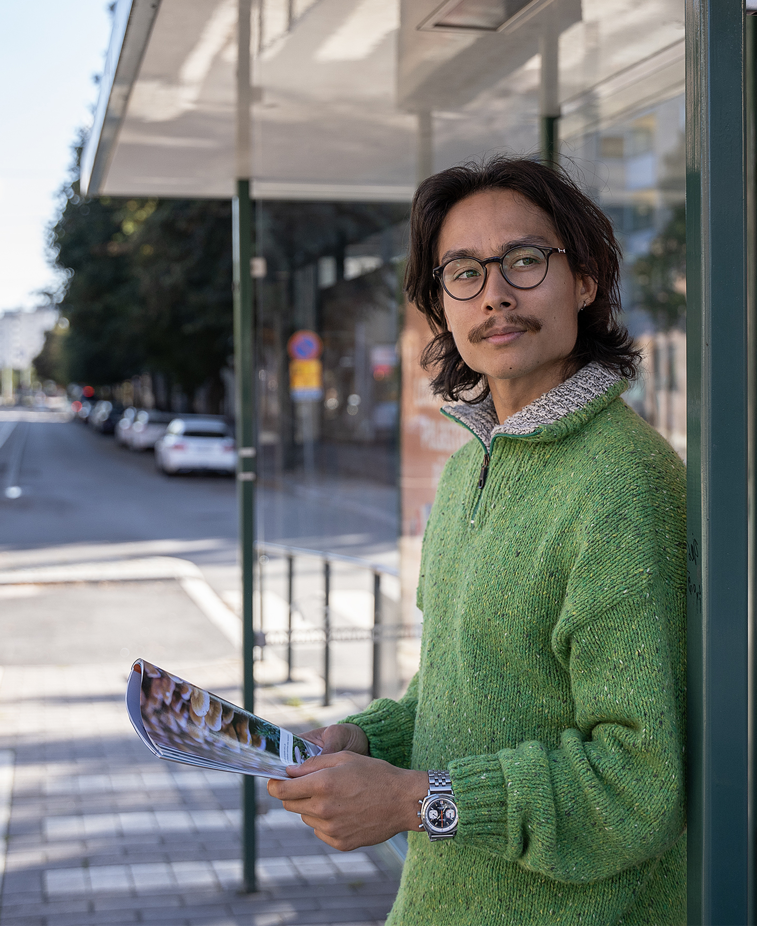

The magazines read the longest are enjoyed for over an hour and a half.
Suomen Kuvalehti is the magazine with the longest reading time for men (1 h 41 min) and for women (1 h 45).

Slide 9
Longest read magazines
Average time spent on one issue and by gender
Magazine | Average reading time, total 15+ population
Suomen Kuvalehti | 1 h 43 min
Viva | 1 h 35 min
Apu | 1 h 35 min
ET-lehti | 1 h 33 min
Seura | 1 h 25 min
Kotimaa | 1 h 24 min
Eeva | 1 h 23 min
Katso | 1 h 22 min
Viherpiha | 1 h 17 min
Tiede | 1 h 17 min
All magazines | 58 min
Magazine | Average reading time, Women
Suomen Kuvalehti | 1 h 45 min
Apu | 1 h 45 min
ET-lehti | 1 h 41 min
Viva | 1 h 37 min
Seura | 1 h 29 min
Eeva | 1 h 24 min
Viherpiha | 1 h 23 min
Kodin Kuvalehti | 1 h 22 min
Kodin Pellervo | 1 h 21 min
Tiede | 1 h 21 min
All magazines | 61 min
Magazine | Average reading time, Men
Suomen Kuvalehti | 1 h 41 min
Kotimaa | 1 h 30 min
Viva | 1 h 26 min
Katso | 1 h 25 min
Seura | 1 h 19 min
Apu | 1 h 18 min
Tekniikan Maailma | 1 h 15 min
Käytännön Maamies | 1 h 15 min
Tiede | 1 h 14 min
Caravan | 1 h 14 min
All magazines | 54 min

Slide 10
Longest read magazines by magazine group
Average time spent on one issue
Professional magazines and organisation magazines | Average reading time
Käytännön Maamies | 1 h 10 min
Lääkärilehti | 1 h 8 min
Koneviesti | 1 h 5 min
Metsänomistajan Aarre | 1 h 2 min
Maatilan Pellervo | 1 h
Metsälehti | 59 min
Tivi | 49 min
Opettaja | 42 min
All professional and organisation magazines | 58 min
Customer magazines | Average reading time
Samarbete | 47 min
Pirkka | 43 min
Yhteishyvä | 42 min
Terveydeksi! | 37 min
Avainapteekit | 32 min
All customer magazines | 40 min
Housing, construction and gardening magazines | Average reading time
Viherpiha | 1 h 17 min
Kotipuutarha | 1 h 14 min
Antiikki & Design | 1 h 10 min
Maalla | 1 h 10 min
Oma Piha | 1 h 4 min
Unelmien Talo & Koti | 1 h 4 min
Meidän Mökki | 1 h 3min
Koti ja Keittiö | 1 h 2 min
Avotakka | 1 h
Deko | 59 min
All housing, construction and gardening magazines | 1 h 5 min

Slide 11
Longest read magazines by magazine group
Average time spent on one issue
Motoring and technical magazines | Average reading time
Tekniikan Maailma | 1 h 11 min
Auto Bild Suomi | 1 h 9 min
Mikrobitti | 1 h 4 min
Tuulilasi | 57 min
Moottori | 53 min
All motoring and technical magazines | 1 h 1 min
Special interest magazines | Average reading time
Kotimaa | 1 h 24 min
Tiede | 1 h 17 min
IS Urheilulehti | 1 h 12 min
Suomen Luonto | 1 h 11 min
Tiede Luonto | 1 h 6 min
Aku Ankka | 51 min
All special interest magazines | 1 h 7 min
Hobby magazines | Average reading time
Suuri Käsityö | 1 h 55 min
Caravan | 1 h 10 min
Kotiliesi Käsityö | 1 h 8 min
Juoksija-lehti | 1 h 2 min
Erä | 58 min
Kippari | 58 min
Metsästys ja Kalastus | 58 min
All hobby magazines | 1 h 6 min

Slide 12
Longest read magazines by magazine group
Average time spent on one issue
Travel magazines | Average reading time
Mondo | 1 h 4 min
Matka | 1 h 3 min
All travel magazines | 1 h 3 min
Women's magazines | Average reading time
Eeva | 1 h 23 min
Kodin Kuvalehti | 1 h 16 min
Kotiliesi | 1 h 16 min
Kodin Pellervo | 1 h 14 min
Kotivinkki | 1 h 9 min
Anna | 1 h 3 min
Me Naiset | 1 h
Gloria | 54 min
All women's magazines | 1 h 13 min
Food and drink magazines | Average reading time
Glorian ruoka&viini | 1 h 7 min
Maku | 1 h 5 min
Viinilehti | 52 min
All food and drink magazines | 1 h 3 min

Slide 13
Longest read magazines by magazine group
Average time spent on one issue
Economy and business magazines | Average reading time
Viisas Raha | 1 h 9 min
Arvopaperi | 1 h 4 min
Talouselämä | 58 min
Taloustaito | 55 min
Tekniikka&Talous | 47 min
All economy and business magazines | 57 min
Health and well-being magazines | Average reading time
ET Terveys | 1 h 14 min
Hyvä Terveys | 1 h 9 min
Voi Hyvin | 1 h 4 min
Apu Terveys | 1 h 1 min
Kauneus & Terveys | 53 min
All health and well-being magazines | 1 h 5 min
General interest magazines | Average reading time
Suomen Kuvalehti | 1 h 43 min
Viva | 1 h 35 min
Apu | 1 h 35 min
ET-lehti | 1 h 33 min
Seura | 1 h 25 min
Kotimaa | 1 h 24 min
Katso | 1 h 22 min
Seiska | 57 min
Hymy | 55 min
All general interest magazines | 1 h 18 min

Slide 14
The Finnish National Readership Survey (NRS) figures for individual magazines can be obtained without registration from Magazine Rate Card service:
www.ratecards.fi
More summaries from the NRS in
Finnish Magazine Media Association’s website:
www.aikakausmedia.fi/en/research

