Slide 1
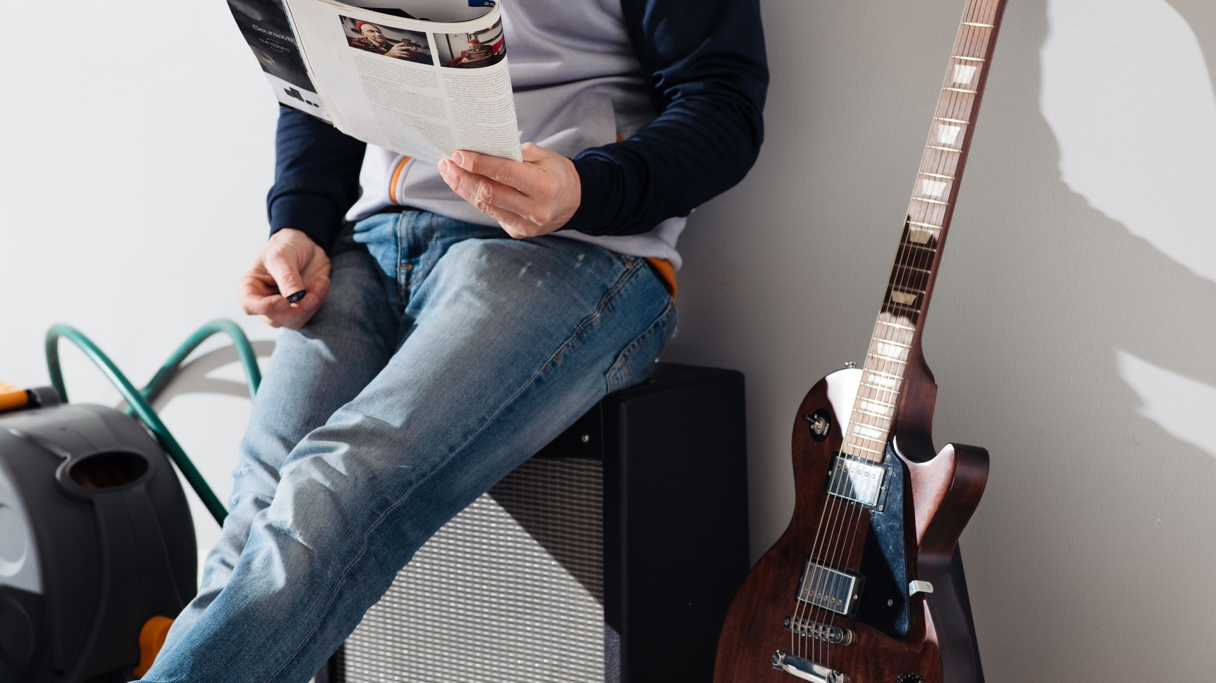

Reading habits & attitude towards advertising
Finnish National Readership Survey 2022

Slide 2
Contents
01
Reading and advertising claims
02
Attitudes towards advertising across channels
03
Advertising blocking
Finnish National Readership Survey 2022

Slide 3
1.
Reading and advertising claims

Slide 4
Of Finns…
81%
think that Finnish magazines are of high quality
78%
say they relax with magazines
69%
think that Finnish magazines offer reliable product recommendations
Source: Finnish National Readership Survey 2022

Slide 5
Of Finns…
81%
get information about their hobbies and interests from a specialist magazine
70%
keep up to date on professional issues with the help of a professional magazine
44%
have purchased products based on magazine ads
Source: Finnish National Readership Survey 2022

Slide 6
Quality claims in magazines
% of Finns, fully or partially agree
Source: Finnish National Readership Survey 2022 | Total population N: 46,996

Slide 7
Finnish magazines are of high quality
Magazines are appreciated in all age groups.
81%
of people over the age of 15 consider Finnish magazines to be of high quality – 84% of women and 77% of men.
% of Finns, totally or partially agree

Slide 8
Finnish magazines are of high quality
Magazines are appreciated in all age groups.
81%
of people over the age of 15 consider Finnish magazines to be of high quality – 84% of women and 77% of men.
% of readers, fully or partially agree
Top magazines | % of readers
Trendi | 91
Gloria | 90
Kotilääkäri | 90
Image | 90
Mondo | 89
Fit | 89
Kauneus & Terveys | 89
Sport | 89

Slide 9
Finnish magazines offer reliable comparisons and tests
69% of people
over the age of 15 rely on comparisons and tests in magazines – 70% of men and 68% of women.
% of Finns, totally or partially agree

Slide 10
Finnish magazines offer reliable comparisons and tests
69% of people
over the age of 15 rely on comparisons and tests in magazines – 70% of men and 68% of women.
% of readers, fully or partially agree
Top magazines | % of readers
Tekniikka&Talous | 78
Vene | 77
Arvopaperi | 77
Talouselämä | 77
Tekniikan Maailma | 76
Tivi | 76
Erä | 76
IS Urheilulehti | 76
Kippari | 76
Viisas Raha | 76
Image | 76

Slide 11
Finnish magazines offer reliable product recommendations
% of Finns, totally or partially agree
64%
of people over the age of 15 rely on the product recommendations of Finnish magazines – 66% of women and 62% of men.

Slide 12
Finnish magazines offer reliable product recommendations
% of readers, fully or partially agree
Top magazines | % of readers
Sport | 76
Fit | 75
Antiikki & Design | 73
Juoksija-lehti | 73
Matka | 73
Mondo | 72
Image | 72
Glorian Koti | 71
Koti ja keittiö | 71
Mikrobitti | 71
Arvopaperi | 71
Talouselämä | 71
Tekniikka&Talous | 71
Voi Hyvin | 71
64%
of people over the age of 15 rely on the product recommendations of Finnish magazines – 66% of women and 62% of men.

Slide 13
I trust the product recommendations of bloggers and YouTubers
% of Finns, totally or partially agree
19%
of people over the age of 15 rely on the product recommendations of bloggers and YouTubers – women (21%) slightly more often than men (16%).
The highest confidence is in the youngest age group.

Slide 14
I trust the product recommendations of bloggers and YouTubers
% of readers, fully or partially agree
19%
of people over the age of 15 rely on the product recommendations of bloggers and YouTubers – women (21%) slightly more often than men (16%).
The highest confidence is in the youngest age group.
Top magazines | % of readers
Trendi | 32
HS Meidän perhe | 30
Fit | 29
Alibi | 25
Aku Ankka | 24
Ruotuväki | 20
Deko | 20
Sport | 20
Image | 19
Seiska | 19

Slide 15
People relax with magazines and get information about their own interests
% of Finns, totally or partially agree
Source: Finnish National Readership Survey 2022 | Total population N: 46,996

Slide 16
A specialist magazine in the field provides information about my hobbies and interests
% of Finns, totally or partially agree
There is a strong demand for specialised periodicals in all age groups.
81%
of people over the age of 15 receive information about their hobbies and interests from a specialist magazine – 79% of women and 84% of men.

Slide 17
A specialist magazine in the field provides information about my hobbies and interests
% of readers, fully or partially agree
There is a strong demand for specialised periodicals in all age groups.
81%
of people over the age of 15 receive information about their hobbies and interests from a specialist magazine – 79% of women and 84% of men.
Top magazines | % of readers
Tivi | 90
Juoksija-lehti | 89
Tekniikka&Talous | 89
Mikrobitti | 88
IS Urheilulehti | 88
Fit | 88
Koneviesti | 87
Käytännön Maamies | 87
TM Rakennusmaailma | 87
Vauhdin Maailma | 87
Mondo | 87
Talouselämä | 87
Askel | 87

Slide 18
I relax and get inspired when reading magazines
% of Finns, totally or partially agree
78%
of people over the age of 15 relax and get inspired by magazines – 86% of women and 71% of men.

Slide 19
I relax and get inspired when reading magazines
% of readers, fully or partially agree
Top magazines | % of readers
Trendi | 91
Gloria | 90
Kotilääkäri | 90
Image | 90
Mondo | 89
Fit | 89
Kauneus & Terveys | 89
Sport | 89
78%
of people over the age of 15 relax and get inspired by magazines – 86% of women and 71% of men.

Slide 20
With the help of a professional magazine, I keep up to date on professional matters
% of Finns, totally or partially agree
For those who have reached working life, a magazine of one's own field plays an important role in maintaining professional skills.
70%
of people over the age of 15 say they stay up to date on professional issues with the help of a professional magazine – 66% of women and 74% of men.

Slide 21
With the help of a professional magazine, I keep up to date on professional matters
% of readers, fully or partially agree
For those who have reached working life, a magazine of one's own field plays an important role in maintaining professional skills.
70%
of people over the age of 15 say they stay up to date on professional issues with the help of a professional magazine – 66% of women and 74% of men.
Top magazines | % of readers
Juoksija | 82
Käytännön Maamies | 81
Opettaja | 81
Tekniikka&Talous | 81
Image | 81
Arvopaperi | 80
Koneviesti | 79
Mikrobitti | 79
Kippari | 79

Slide 22
Reader engagement – print and social media
% of Finns, fully or partially agree
Source: Finnish National Readership Survey 2022 | Total population N: 46,996

Slide 23
I read magazines that are important to me from cover to cover
% of Finns, totally or partially agree
54%
of people over the age of 15 read their magazines from cover to cover – 59% of women and 48% of men.

Slide 24
I read magazines that are important to me from cover to cover
% of readers, fully or partially agree
Top magazines | % of readers
ET | 69
Kotivinkki | 68
Samarbete | 67
Viherpiha | 67
Mondo | 67
Eeva | 67
Voi Hyvin | 67
Avotakka | 66
Maalla | 66
Kotiliesi Käsityö | 66
ET Terveys | 66
Viva | 66
54%
of people over the age of 15 read their magazines from cover to cover – 59% of women and 48% of men.

Slide 25
I follow magazines that are important to me in social media
% of Finns, totally or partially agree
31%
of people over the age of 15 follow magazines important to them in social media.
There is no significant difference between women (33%) and men (30%).

Slide 26
I follow magazines that are important to me in social media
% of readers, fully or partially agree
Top magazines | % of readers
Trendi | 42
Fit | 42
HS Meidän perhe | 41
Alibi | 40
Sport | 38
Tivi | 36
Mondo | 36
Juoksija-lehti | 35
Maku | 35
Aku Ankka | 35
31%
of people over the age of 15 follow magazines important to them in social media.
There is no significant difference between women (33%) and men (30%).

Slide 27
Advertising in magazines makes new products and services familiar
% of Finns, totally or partially agree
Source: Finnish National Readership Survey 2022 | Total population N: 46,996

Slide 28
Magazine advertising makes new products and services familiar
% of Finns, totally or partially agree
67%
of people over the age of 15 say that magazine ads make new products and services familiar.
73% of women and 60% of men agree with this claim.

Slide 29
Magazine advertising makes new products and services familiar
% of readers, fully or partially agree
Top magazines | % of readers
Fit | 79
Kauneus & Terveys | 77
Unelmien Talo & Koti | 76
Kotiliesi Käsityö | 76
Suuri Käsityö | 76
Viva | 76
Gloria | 75
Kotivinkki | 75
Trendi | 75
Maku | 75
Kotilääkäri | 75
HS Meidän perhe | 75
67%
of people over the age of 15 say that magazine ads make new products and services familiar.
73% of women and 60% of men agree with this claim.

Slide 30
Advertisements are a natural part of a magazine's content
% of Finns, totally or partially agree
62%
of people
over the age of 15 feel that advertising belongs to a magazine's content.
63% of women and 61% of men agree with this claim.

Slide 31
Advertisements are a natural part of a magazine's content
% of readers, fully or partially agree
62%
of people
over the age of 15 feel that advertising belongs to a magazine's content.
63% of women and 61% of men agree with this claim.
Top magazines | % of readers
Mondo | 71
Antiikki & Design | 70
Arvopaperi | 70
Talouselämä | 70
Tekniikka&Talous | 70
Viisas Raha | 70
Fit | 70
HS Meidän perhe | 70
Image | 70
Gloria | 69
Trendi | 69
Sport | 69

Slide 32
Advertising in a magazine generates activity
% of Finns, totally or partially agree
Source: Finnish National Readership Survey 2022 | Total population N: 46,996

Slide 33
I try out tips or guidelines (e.g., recipes) in magazine ads
% of Finns, totally or partially agree
Recipes and other instructions in advertisements activate!
60%
of people over the age of 15 experiment with tips or guidelines in magazine ads.
72% of women and 47% of men agree with this claim.

Slide 34
I try out tips or guidelines (e.g., recipes) in magazine ads
% of readers, fully or partially agree
Recipes and other instructions in advertisements activate!
60%
of people over the age of 15 experiment with tips or guidelines in magazine ads.
72% of women and 47% of men agree with this claim.
Top magazines | % of readers
Trendi | 77
Fit | 77
Gloria | 75
HS Meidän perhe | 75
Suuri Käsityö | 73
Sport | 73
Koti ja keittiö | 72
Kotiliesi Käsityö | 71
Kauneus & Terveys | 71

Slide 35
I have sought more information about a product advertised in the magazine, for example, online
% of Finns, totally or partially agree
51%
of people over the age of 15 have sought more information about the product thanks to an advertisement in a magazine – 51% of women and 51% of men.

Slide 36
I have sought more information about a product advertised in the magazine, for example, online
% of readers, fully or partially agree
Top magazines | % of readers
Alibi | 62
Trendi | 60
Tekniikka&Talous | 59
Fit | 59
Kippari | 58
Seiska | 58
Mikrobitti | 57
Vene | 57
Kauneus & Terveys | 57
HS Meidän perhe | 57
51%
of people over the age of 15 have sought more information about the product thanks to an advertisement in a magazine – 51% of women and 51% of men.

Slide 37
I have purchased products based on ads I have seen in a magazine
% of Finns, totally or partially agree
44%
of people over the age of 15 have bought products based on magazine advertisements – 50% of women and 37% of men.

Slide 38
I have purchased products based on ads I have seen in a magazine
% of readers, fully or partially agree
Top magazines | % of readers
Fit | 58
Sport | 57
Trendi | 56
HS Meidän perhe | 55
Unelmien Talo & Koti | 54
Gloria | 54
Kotivinkki | 54
Kauneus & Terveys | 54
Alibi | 54
Mondo | 53
Maku | 53
44%
of people over the age of 15 have bought products based on magazine advertisements – 50% of women and 37% of men.

Slide 39
I try product samples in magazines (e.g., food or cosmetics)
% of Finns, totally or partially agree
Product samples entice people to try the products and make them familiar.
39%
of people over the age of 15 try product samples in magazines – 56% of women and 21% of men.

Slide 40
I try product samples in magazines (e.g., food or cosmetics)
% of readers, fully or partially agree
Product samples entice people to try the products and make them familiar.
39%
of people over the age of 15 try product samples in magazines – 56% of women and 21% of men.
Top magazines | % of readers
Trendi | 63
Fit | 60
HS Meidän perhe | 59
Gloria | 56
Kotiliesi Käsityö | 55
Suuri Käsityö | 55
Kauneus & Terveys | 55
Koti ja keittiö | 54
Askel | 54
Viva | 54

Slide 41
2.
Attitudes towards advertising across channels

Slide 42
76% of Finns over the age of 15 are positive about magazine advertising.
Women (79%) are slightly more positive than men (73%).
In particular, magazine advertising is enjoyed by people aged 45 to 54, 80% of whom are positive about it.
Source: Finnish National Readership Survey 2022

Slide 43
% of Finns who take a positive view of advertising very or quite a positive view
76% of Finns are positive about magazine advertising.
Source: Finnish National Readership Survey 2022 | Total population N: 46,996

Slide 44
% of Finns who take a negative view of advertising very or quite a negative view
Advertising in digital channels is viewed more negatively.
Source: Finnish National Readership Survey 2022 | Total population N: 46,996

Slide 45
3.
Advertising blocking

Slide 46
19%
of Finns over the age of 15 block advertising with Adblocker or a similar application.
23% have a advertising ban on their door.
Source: Finnish National Readership Survey 2022

Slide 47
Use of Adblocker or equivalent
Advertising is more often prevented by people under 35 than by older age groups.
Men (28%) prevent advertising more often than women (11%).
% of Finns, by age group

Slide 48
Advertising ban on the door
More often, direct mail is banned by 25–34 year olds (43%).
At the population level, there are no major differences between men (23%) and women (23%).
% of Finns, by age group

Slide 49
The Finnish National Readership Survey figures for individual magazines can be obtained without registration from Magazine Rate Card service:
www.ratecards.fi
More summaries from the NRS in
Finnish Magazine Media Association’s website:
www.aikakausmedia.fi/en/research

Slide 50
Aikakausmedia.fi/en │ Ratecards.fi

