Slide 1
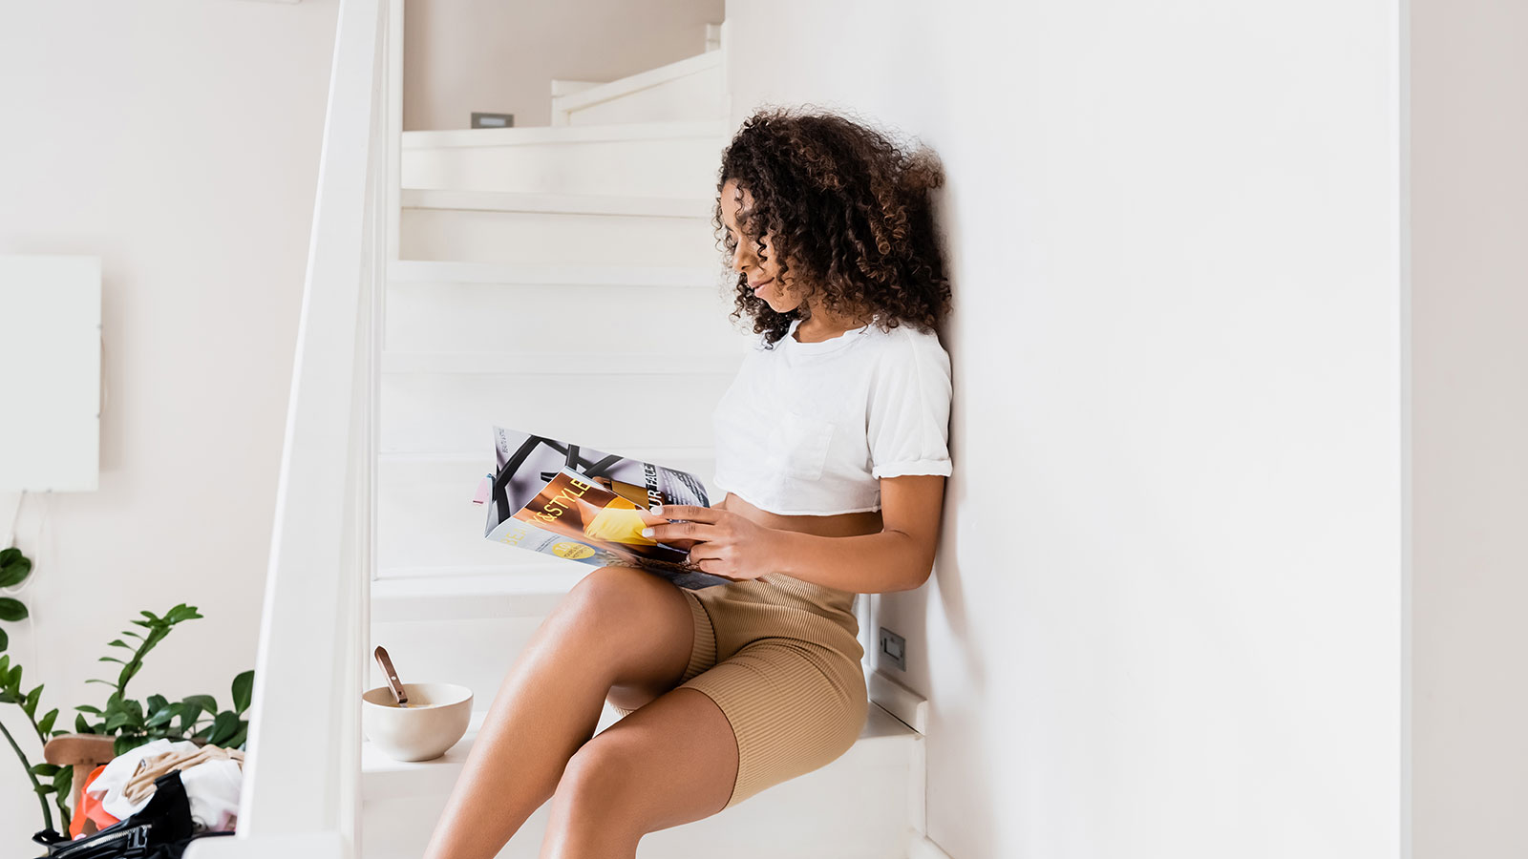

Reading times & number of readings
Finnish National Readership Survey 2022

Slide 2
Contents
01
Number of minutes by magazine group
02
Number of readings by magazine group
03
Longest read magazines
Finnish National Readership Survey 2022

Slide 3
Note!
The number of minutes should not be compared to the results of the previous Finnish National Readership Survey (NRS), as the measurement method has been changed.
The number of readings, on the other hand, are comparable with the previous data.

Slide 4
On average, 53 minutes is spent reading a magazine issue.
Women spend most of their time with women's magazines (75 min), health and well-being magazines (69 min) and general interest magazines (63 min).
Men enjoy the longest hobby magazines (61 min) and motoring and tech magazines (58 min).
Source: Finnish National Readership Survey 2022
Total population N: 46,996

Slide 5
Number of minutes by magazine group
Average amount of time spent on one issue, minutes, averages by magazine group
Magazine group | Total 15+ population, average minutes | Women, average minutes | Men, average minutes
Women's magazines | 69 | 75 | 40
Health and well-being magazines | 64 | 69 | 46
Hobby magazines | 63 | 59 | 61
General interest magazines | 57 | 63 | 49
Housing, construction and gardening magazines | 57 | 61 | 46
Motoring and technical magazines | 55 | 38 | 58
Food and drink magazines | 55 | 61 | 40
Economy and business magazines | 47 | 45 | 49
Professional magazines and magazines published by non-profit organisations | 47 | 41 | 51
Customer magazines | 36 | 40 | 29
All magazines | 53 | 55 | 47
Source: Finnish National Readership Survey 2022 | Total population N: 46,996, women N: 23,246, men N: 23,750

Slide 6
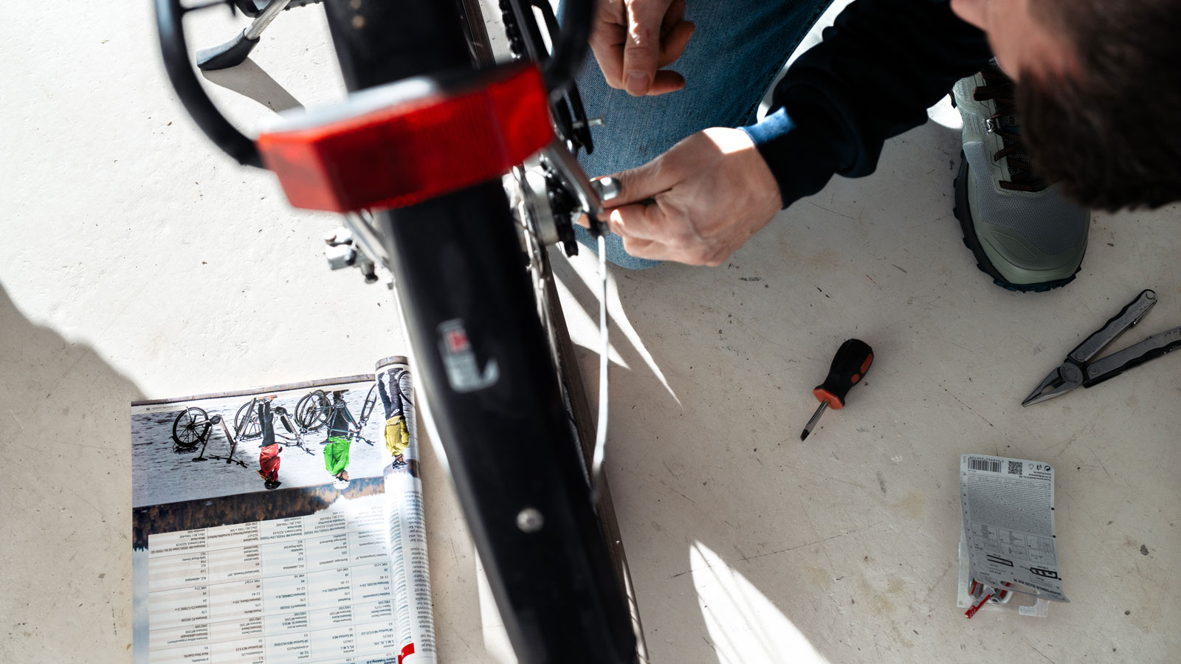

On average, one issue of a magazine is taken twice.
Food and beverage magazines (2.7 readings) and hobby magazines (2.5 readings) receive the highest number of readings.
There is no great variation in the number of readings of magazines in different magazine groups; even customer magazines that collect the least readings are viewed an average of 1.5 times.
Source: Finnish National Readership Survey 2022
Total population N: 46,996

Slide 7
Number of readings by magazine group
Average number of readings per magazine issue, average by magazine group
Magazine group | Total 15+ population, average number of readings | Women, average number of readings | Men, average number of readings
Food and drink magazines | 2.7 | 2.9 | 2.2
Hobby magazines | 2.5 | 2.7 | 2.3
General interest magazines | 2.2 | 2.4 | 2.1
Women's magazines | 2.2 | 2.3 | 1.5
Housing, construction, gardening magazines | 2.2 | 2.4 | 1.8
Health and well-being magazines | 2.1 | 2.2 | 1.6
Motoring and technical magazines | 2.1 | 1.6 | 2.1
Professional magazines and magazines published by non-profit organisations | 1.9 | 1.5 | 2.2
Economy and business magazines | 1.8 | 1.6 | 1.9
Customer magazines | 1.5 | 1.7 | 1.4
All magazines | 2.0 | 2.1 | 1.9
Source: Finnish National Readership Survey 2022 | Total population N: 46,996, women N: 23,246, men N: 23,750

Slide 8
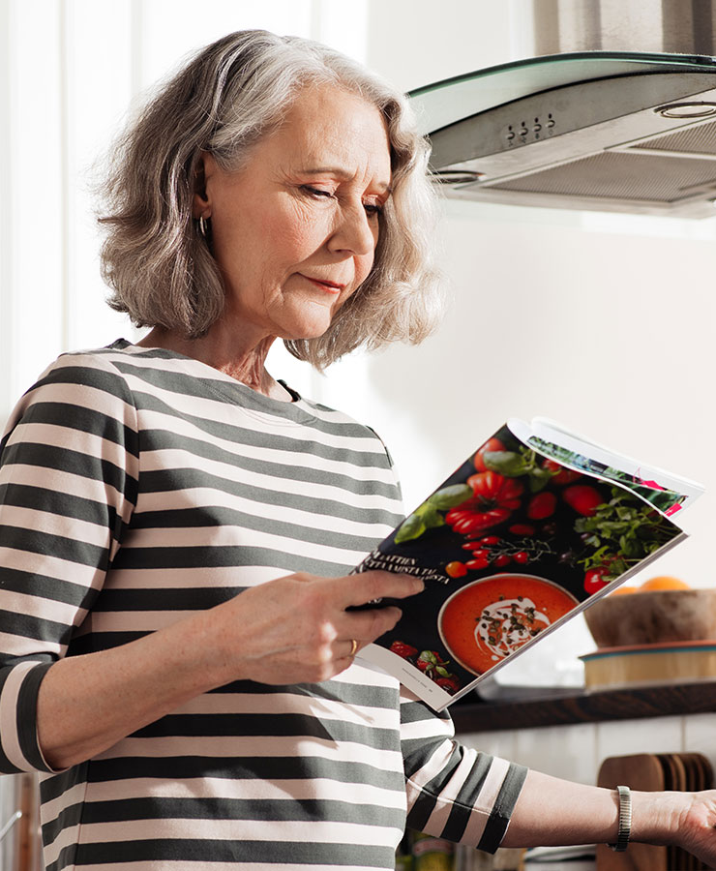
The magazines read the longest are enjoyed for over an hour.
Eeva (a women’s magazine) is the magazine with the longest reading time (88 min).
Source: Finnish National Readership Survey 2022
Total population N: 46,996

Slide 9
Longest read magazines
Average time spent on one issue, minutes, averages by magazine and gender
Magazine | Reading minutes, 15+ population
Eeva | 88
Suomen Kuvalehti | 87
Image | 80
Apu | 79
Valitut Palat | 79
Seura | 78
Tiede | 78
ET-lehti | 77
Voi hyvin | 75
Eeva | 88
Suomen Kuvalehti | 87
All magazines | 53
Magazine | Reading minutes, women
Tiede | 103
Eeva | 93
Suomen Kuvalehti | 91
Apu | 90
ET-lehti | 86
Seura | 85
Image | 84
Valitut Palat | 83
Apu Terveys | 82
Kotiliesi | 81
All magazines | 55
Magazine | Reading minutes, men
Suomen Kuvalehti | 82
Valitut Palat | 75
Image | 73
Tiede | 72
Tekniikan Maailma | 70
Caravan | 69
IS Urheilulehti | 68
Seura | 67
Vene | 65
Mikrobitti | 64
All magazines | 47
Source: Finnish National Readership Survey 2022 | Total population N: 46,996, women N: 23,246, men N: 23,750

Slide 10
Longest read magazines by magazine group
Average time spent on one issue, minutes, averages by magazine
Consumer magazines | Reading minutes, 15+ population
Eeva | 88
Suomen Kuvalehti | 87
Image | 80
Apu | 79
Valitut Palat | 79
Seura | 78
Tiede | 78
Et-lehti | 77
Voi hyvin | 75
Eeva | 88
Suomen Kuvalehti | 87
All consumer magazines | 53
Professional magazines and magazines published by non-profit organisations | Reading minutes, 15+ population
Käytännön Maamies | 59
Koneviesti | 54
Maatilan Pellervo | 51
Aarre | 51
Metsälehti | 50
Aarre | 40
Ruotuväki | 37
Opettaja | 32
All professional and non-profit prganization magazines | 47
Customer magazines | Reading minutes, 15+ population
Yhteishyvä | 39
Pirkka | 38
Samarbete | 37
Terveydeksi! | 33
Avainapteekit | 28
All customer magazines | 36
Source: Finnish National Readership Survey 2022 | Total population N: 46,996

Slide 11
Longest read magazines by magazine group
Average time spent on one issue, minutes, averages by magazine
Housing, construction and gardening | Reading minutes, 15+ population
Viherpiha | 68
Antiikki & Design | 65
Avotakka | 63
Maalla | 60
Meidän Mökki | 45
Unelmien Talo & Koti | 53
Oma Piha | 53
Koti ja Keittiö | 53
Glorian Koti | 52
TM Rakennusmaailma | 51
All housing, construction and gardening magazines | 57
Motoring and technical magazines | Reading minutes, 15+ population
Tekniikan Maailma | 66
Mikrobitti | 61
Moottori | 50
Tuulilasi | 50
Auto Bild Suomi | 48
Vauhdin Maailma | 48
Tivi | 44
All motoring and technical magazines | 55
Hobby magazines | Reading minutes, 15+ population
Tiede | 78
Suomen Luonto | 74
Suuri Käsityö | 73
IS Urheilulehti | 65
Kotiliesi Käsityö | 63
Caravan | 63
Vene | 60
Tiede Luonto | 59
Matka | 58
Juoksija | 58
All hobby magazines | 63
Source: Finnish National Readership Survey 2022 | Total population N: 46,996

Slide 12
Longest read magazines by magazine group
Average time spent on one issue, minutes, averages by magazine
Women's magazines | Reading minutes, 15+ population
Eeva | 88
Kotiliesi | 74
Kodin Kuvalehti | 69
Kodin Pellervo | 66
Anna | 64
Kotivinkki | 62
Me Naiset | 59
Trendi | 50
Gloria | 49
All women's magazines | 69
Food and drink magazines | Reading minutes, 15+ population
Maku | 56
Glorian ruoka&viini | 54
All food and drink magazines | 55
Economy and business magazines | Reading minutes, 15+ population
Arvopaperi | 53
Veronmaksajan Taloustaito | 51
Talouselämä | 49
Viisas Raha | 48
Tekniikka&Talous | 39
Yrittäjä-lehti | 33
All economy and business magazines | 47
Source: Finnish National Readership Survey 2022 | Total population N: 46,996

Slide 13
Longest read magazines by magazine group
Average time spent on one issue, minutes, averages by magazine
Health and well-being magazines | Reading minutes, 15+ population
Voi Hyvin | 75
Apu Terveys | 73
ET Terveys | 66
Hyvä Terveys | 62
Kotilääkäri | 59
Kauneus & Terveys | 57
Sport | 50
Fit | 47
All health and well-being magazines | 64
General interest magazines | Reading minutes, 15+ population
Suomen Kuvalehti | 86
Image | 80
Valitut Palat | 79
Apu | 79
Seura | 78
ET -lehti | 77
Viva | 74
Kotimaa | 67
Katso | 64
HS Meidän perhe | 64
All general interest magazines | 69
Source: Finnish National Readership Survey 2022 | Total population N: 46,996

Slide 14
The Finnish National Readership Survey (NRS) figures for individual magazines can be obtained without registration from Magazine Rate Card service:
www.ratecards.fi
More summaries from the NRS in
Finnish Magazine Media Association’s website:
www.aikakausmedia.fi/en/research

Slide 15
Aikakausmedia.fi/en │ Ratecards.fi

