Slide 1
ASSI
Research summary on customer magazine reading and advertising in Finland
2022

Slide 2
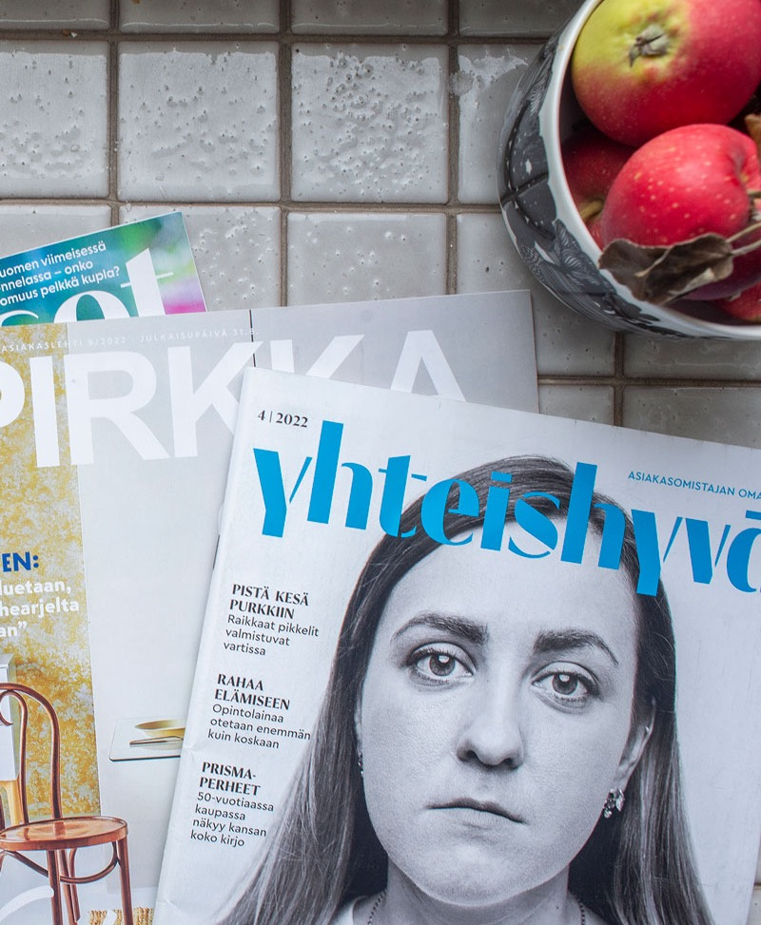
Customer media reach two thirds of the population
Customer media are the largest form of magazine media – mass media in the fractured media consumption landscape. The average Finnish person reads 1.2 customer magazines in print.
The 5 customer media included in the National Readership Survey (NRS 2022) reach 2,858,000 Finns over the age of 15. This is 67% of the entire population.
The largest customer media, Yhteishyvä, reaches 2.2 million Finns.
Source: NRS 2022

Slide 3
Contents
01
Information about the study
05
Advertising
02
Reading
06
Respondents’ background information
03
Customer relationship
07
Summary
04
Studied articles

Slide 4
1.
Information about the study

Slide 5
7 studied customer media
5,117 respondents
The study was carried out between June and December 2022.
The method used was an online survey for each company’s customers.
Study conducted by: JHelske Research | client: Finnish Magazine Media Association

Slide 6
The customer media included in the study
Avainapteekit
Publisher: Avainapteekit Oy (a pharmacy store chain)
Published six times a year
The magazine covers topics related to health and well-being and presents monthly offers.
The printed magazine in available in Avainapteekit pharmacies and delivered to people living near business premises. The electronic magazine is available online.

Slide 7
The customer media included in the study
Etiketti/Etiketten
Publisher: Alko Oy (Alko is the Finnish monopoly for distribution of wine, beer and spirits)
Published four times a year.
Published in Finnish and Swedish (this study included both language versions).
Etiketti serves those with a taste for good food and drink. The magazine includes topical recipes, articles and wine information. Etiketti helps readers choose food and drink pairings and gives advice on responsible drinking.
The print magazine is available in Alko stores, and the electronic magazine is available online.

Slide 8
The customer media included in the study
Helen
Publisher: Helen Oy (one of the largest energy companies in Finland).
Published twice a year.
Published in Finnish, Swedish and English (this study included the Finnish language version).
The magazine covers topics related to energy.
The print magazine is delivered to customers’ homes, the electronic magazine is available online as a downloadable PDF.

Slide 9
The customer media included in the study
Sisustamo
Publisher: Vepsäläinen Oy (a furniture store)
Published twice a year.
Sisustamo is a customer magazine for furniture store Vepsäläinen. The magazine offers ideas and inspiration for homes, presents modern designers and tells the interesting stories behind products.
The print magazine is available in stores and can be pre-ordered for home delivery by issue, free of charge.

Slide 10
The customer media included in the study
Terve Metsä
Publisher: Stora Enso (a manufacturer of pulp, paper and other forest products)
Published four times a year, can be ordered free of charge.
The magazine is targeted at forest owners and includes both light articles and information about forest ownership.
The print magazine is delivered to people’s homes, and the electronic magazine is available online.

Slide 11
The customer media included in the study
Uniikki
Publisher: Yliopiston Apteekki (a pharmacy store chain)
Published three times a year.
Uniikki offers information on health, well-being and beauty. The magazine includes tips from professionals on topics like good nutrition and skin care.
The print magazine is available in stores and mailed to customers who have purchased products from Yliopiston Apteekki in the last six months. The electronic magazine is available online.

Slide 12
The customer media included in the study
Vinkkari
Publisher: Braleva Kiinteistöpalvelut Oy (Braleva offers real estate management, property maintenance and other services for housing associations).
Published four times a year.
Vinkkari is designed for housing company residents
and shareholders. The magazine includes useful information on living.
The magazine is distributed to all apartments of Braleva’s customer companies and to property shareholders who live elsewhere. The magazine can be ordered free of charge, even if you are not a customer.

Slide 13
The studied customer media...
...were free publications targeted at consumer customers.
...were published 2–6 times a year. Two magazines were published in several languages.
...were either magazines you could take with you from the store (1), magazines that were mailed to your home (3) or available both ways (3). With one exception, all magazines were available as digital magazines.
...focused on health, well-being, food and drink, energy, furnishing, forests and living.
The industries of the companies publishing the magazines: pharmacies, alcohol and other drinks, the energy industry, furniture industry, forest industry and property and property management industry.

Slide 14
2.
How customer media are read

Slide 15
Customer magazines are mainly read in print
% of respondents who read the studied issue, N = 3,872
(Readers of 6 magazines were surveyed.)
For the magazine issues studied,
97%
read the magazine in print.
The proportion of print readers varied from 95% to 99% between magazines.

Slide 16
The people who read digital read most on the computer
For people who read the studied magazine issue digitally,
51%
read the magazine on a desktop or laptop computer.
One factor that affects the device ratios is that the study asked respondents about reading a single issue, meaning a digital edition.
What device did you use to read the magazine?
% of people who read the studied magazine issue digitally N = 105
(Readers of 6 magazines were surveyed.)

Slide 17
Regularity: The majority of readers read each published issue
How regularly do you usually read this magazine?
% of respondents N = 5,177
70%
read
each published issue.
80% read at least every other issue.
The proportion of people who read
each issue varied between 50% and 84%.

Slide 18
A total of 84% of print magazine readers read every issue – over half of all digital readers also do the same
% of respondents who read every issue | N = 4,992
The proportion of regular readers was the largest among the oldest age category.
The distribution method matters – readership is the most regular for home-delivered print magazines.

Slide 19
People spend half an hour reading a single customer magazine issue.
The average reading time for a single issue is
29 minutes.
Actual reading times vary from 20 to 35 minutes. The number of pages is strongly correlated with reading time.
How long do you usually read or browse one issue of this magazine?
Include the total number of times you read a single issue. | % of respondents, N = 4,992

Slide 20
Reading times by method and age
(average reading time for a single issue in minutes)
How long do you usually read or browse one issue of this magazine?
Include the total number of times you read a single issue | % of respondents, N = 4,992
Reading time is at its highest among the oldest age groups.
Print magazine readers spend more time on customer magazines than those who read digitally.
minutes

Slide 21
Customer magazines are typically read by two people – 56% share the magazine with someone else
How many others besides you read each issue of the magazine?
% of respondents N = 4,992
The average number of people reading each issue of the studied magazines is
1.7
people.
Print and digital readers do not differ from each other in this regard.

Slide 22
One issue of a customer magazine is typically read or browsed twice
On average, one issue of each studied magazine is read
2.0 times.
Print magazine readers
read or browse the magazine 2.2 times.
Digital readers read or browse the magazine 1.8 times.
How many times do you read or browse the same issue of a magazine?
% of respondents N = 4,992

Slide 23
Customer magazines typically have long-term readerships
73%
have read a magazine for
over 3 years.
Nearly half have read the magazine for
over 5 years.
There are slightly more new readers among digital readers.
How long have you been reading this magazine? | % of respondents N = 4,992

Slide 24
Key figures about reading
97% read customer magazines in print. The most popular digital reading device is the computer.
Reading is regular – 70% read each issue. A home-delivered print magazine reaches readers more regularly than a magazine that is available at business premises or digitally.
The average reading time for a single issue is 29 minutes. Reading time increases with age. Print magazines are read for longer than digital magazines.
Half of the respondents said that someone else also reads the magazine – one issue has an average of 1.7 readers.
On average, one issue of each magazine is read 2.0 times.
Readership is long-term – 73% have read a magazine for over 3 years.

Slide 25
3.
Readership

Slide 26
Where would you prefer to read news and articles about the industry or organization represented by this magazine (choose the most important)?
57%
preferred to follow a magazine’s or it publishing company’s topics in a print magazine.
Customer media readers have a strong preference for print magazines when compared to readers of professional and organization media.
(57% vs. 47%).
When it comes to digital channels, customer media readers prefer newsletters more than professional and organization media
readers (9% vs. 2%).
% of respondents N = 4,992

Slide 27
Print magazines are the most preferred way of receiving information in all age groups. The most preferred digital form of communication is a newsletter.
Where would you prefer to read news and articles about the industry or organization represented by this magazine (choose the most important)? % of respondents N = 4,992

Slide 28
Where would you prefer to read news and articles about the industry or organization represented by this magazine (choose the most important)? Print magazine readers
% of respondents N = 3,638
61%
of print magazine readers preferred to follow a magazine’s or it publishing company’s topics in a print magazine.

Slide 29
Where would you prefer to read news and articles about the industry or organization represented by this magazine (choose the most important)? Digital magazine readers
% of respondents N = 105
31%
of digital magazine readers preferred to follow a magazine’s or it publishing company’s topics in a print magazine.
Note! For digital readers, a newsletter is an equally preferrable way to find news and articles.

Slide 30
Where would you prefer to read news and articles about the industry or organization represented by this magazine (choose the most important)? People under 30
% of respondents N = 99
50%
of people under 30 preferred to follow a magazine’s or it publishing company’s topics in a print magazine.

Slide 31
Where would you prefer to read news and articles about the industry or organization represented by this magazine (choose the most important)? People aged 30–39
% of respondents N = 269
55%
of 30–39-year-olds preferred to follow a magazine’s or it publishing company’s topics in a print magazine.

Slide 32
Where would you prefer to read news and articles about the industry or organization represented by this magazine (choose the most important)? People aged 40–49
% of respondents N = 605
52%
of 40–49-year-olds preferred to follow a magazine’s or it publishing company’s topics in a print magazine.

Slide 33
Where would you prefer to read news and articles about the industry or organization represented by this magazine (choose the most important)? People aged 50–64
% of respondents N = 2,012
57%
of 50–64-year-olds preferred to follow a magazine’s or it publishing company’s topics in a print magazine.

Slide 34
Where would you prefer to read news and articles about the industry or organization represented by this magazine (choose the most important)? People over 65
% of respondents N = 2,006
59%
of people over 65 preferred to follow a magazine’s or it publishing company’s topics in a print magazine.

Slide 35
Most say that the magazine they read is published frequently enough – 14% wish for more issues
85%
say that the publishing frequency is appropriate. Almost nobody wishes for fewer issues.
People who read magazines that were published less frequently more often wished for more issues.
The response “The magazine is not published often enough” was chosen 3%–25% of the time
depending on the magazine.
Do you think the magazine is published... | % of respondents, N = 4,992

Slide 36
How often do you visit the website of this magazine?
38%
use the websites or online stores of the studied magazines at least once a month,
87%
at least sometimes.
The rates varied between 17% and 58%
(once a month)
Note! The question was formatted differently depending on a company’s/magazine’s online presence. | % of respondents, N = 4,992

Slide 37
Facebook is both the most commonly used channel by magazines and the most followed channel
25%
follow the social media channel of at least one customer medium that they read.
% of respondents N = 4,992

Slide 38
Customer media on social media
The Finnish Magazine Media Association’s social media survey, December 2022

Slide 39
Customer media had a total of 307,884 followers on social media
The survey included 6 customer media.
By the end of 2022, customer media had nearly
308,000
followers.
Customer media are followed most on Instagram and Facebook.

Slide 40
Customer media follower numbers / December 2022
All followers, users who gave likes and subscribers for all surveyed media on Facebook, Instagram, Twitter, YouTube, Pinterest and TikTok. Overlap has not been taken into account.
The survey included 6 customer media that used a total of 14 social media channels.
One customer medium used an average of
2.3
social media channels.

Slide 41
The largest customer media on social media / December 2022
Largest media
Instagram
Yhteishyvä
K-Ruoka
Pirkka
Facebook
Yhteishyvä
X
Polemiikki
YouTube
K-Ruoka
Yhteishyvä
Pirkka
TikTok
Pirkka
All followers, users who gave likes and subscribers for all surveyed media on Facebook, Instagram, Twitter, YouTube, Pinterest and TikTok. Overlap has not been taken into account.
 | Total followers on all channels | Number of followers
1. | Yhteishyvä | 227,061
2. | K-Ruoka | 51,359
3. | X (Customer media of Veikkaus) | 38,195
4. | Pirkka | 26,814
5. | Polemiikki | 25,480
6. | Sosiaalivakuutus | 24,273
 | Total | 307,884

Slide 42
Average audience size /
December 2022
One customer medium has an average of
51,314
followers on different social media channels.

Slide 43
Customer media are viewed very positively
68%
view customer magazines positively.
1%
have a
negative view.
How would you describe your attitude towards customer magazines in general?
% of respondents N = 4,992

Slide 44
Customer magazines have a very positive impact on company image
Customer media builds the publisher’s image.
84%
say customer media has a positive or quite positive impact on them.
How has this magazine affected your perception of the company that publishes it? | % of respondents N = 4,992

Slide 45
Customer media affects a company’s image
A more diverse look into the publisher’s world – the magazine provides information and perspectives that readers would have not have otherwise considered
“I used to think that Vepsäläinen was completely out of my price range. Now, I’ve noticed that they also have more affordable products. Not everything is “super expensive”.
“I didn’t have almost any information on Braleva before. Diverse operations.”
“I knew basically nothing about the company beforehand, except for things about wood sales. In the magazine, I’ve read about their history, product development, concern for environmental matters etc. In other words, I’ve gotten a broader perspective about the field.”
“It’s made my perception of the company more diverse.”
“The articles about Alko are written appropriately, and I think they’ve given good reasons for why Alko is necessary.”

Slide 46
How important is this magazine as a customer benefit?
77%
say that the studied magazines are a quite important or very important customer benefit.
% of respondents N = 4,992

Slide 47
Why the magazine is important
A reminder of the customer relationship
“I remember forest matters when Terve Metsä drops into my mail box.”
“It’s always good to be reminded about the customer relationship, you also get info about new products”
“Otherwise, I might forget my membership card in my wallet!”
“It’s a nicely made magazine. Useful info. I never remember/can’t be bothered to get it online.”

Slide 48
Why the magazine is important
Familiarizes readers with the company and brings it closer to them
“Otherwise the company would feel very distant, and I wouldn’t look for information.”
“It somehow feels nice to get a magazine from Vepsäläinen, it’s like a postcard from a friend who wants to remember you”
“The magazine brings the big company closer to ordinary citizens and softens the image of an otherwise distant corporation.”
“I know more about the company.”
“It somehow makes you feel like they care about the customer when they send you current information about the company, and you don’t feel like they only focus on taking your money “under the radar”

Slide 49
Why the magazine is important
The only print magazine many get in their mailbox – it stands out from others
“I’m not subscribed to any magazine at the moment, so it’s nice to read other things besides the Helsingin Sanomat newspaper.”
“Different social media channels are so full of messages that even interesting things get lost, because you don’t have the energy to follow dozens of channels. A print magazine is a refreshing exception, and I sometimes browse it very carefully.”
“These days, you barely get any mail, so when this magazine gets delivered, it feels more like “real mail” than an ad.”
“The magazine is the only health-related magazine I get, and the suitability tips in its product ads (e.g. for skin care products) give more information that the package labelling. I also rarely read ads sent to my email, so I mostly see ads for products through the magazine.”

Slide 50
Why the magazine is important
Inspires and familiarizes readers with new products – offers are also important for many readers
“I read the magazine to get inspiration and learn about new products.”
“The magazine articles, ads etc. are easy to read about at your own pace at home, and then it’s easier to make decisions about what to buy. The prices are also important, and so are product labels and the product’s effects.”
“The magazine gives good tips for many things and you also see the things like the monthly offers.”
“The magazine makes you want to buy things and gives you new ideas for interior design.”
“I make sure to remember things like the important monthly offers.”

Slide 51
Why the magazine is important
A high-quality, free magazine is a sign of respect towards customers
“It’s nice that it’s free and makes you want to read it. Good recipes !”
“Getting the magazine tells you that they appreciate the customer and want to support the customer’s health.”
“A free high-quality customer magazine is a good thing”
“I think the magazine is a sign of respect towards the customer during this time where energy prices are difficult.
Good information makes things less frustrating.”
“Other food and wine magazines are pretty expensive. It feels like by distributing the magazine, Alko shows that it appreciates the customer.”

Slide 52
The effects of the magazine
“I love following new furniture trends in your magazine and to be inspired by them.”
“The magazine has important information about new products. Unique offers etc...”
“There’s lots of new info about new wines, new wine countries as well as wine reviews, good recipes.”
Which statements best describe the actions or attitudes that this magazine has led you to? | % of respondents N = 4,992

Slide 53
The effects of the magazine
“The magazine has interesting things that you wouldn’t think about otherwise. Especially for people living in the city.”
“You get information that you wouldn’t get otherwise. You don’t always realize you should ask, or show your ignorance.”
“The magazine also has news and facts about the company, which would otherwise be left unknown.”
Which statements best describe the actions or attitudes that this magazine has led you to? | % of respondents N = 4,992

Slide 54
The effects of the magazine
“It’s nice to curl up on the couch and read your magazine while relaxing.”
“The magazine has interesting and varied articles that I’m happy to read when I have the time.”
“The Magazine has nice articles that are actually interesting. The crossword at the end is also a great idea!”
Which statements best describe the actions or attitudes that this magazine has led you to? | % of respondents N = 4,992

Slide 55
The effects of the magazine
“The Sisustamo magazine gives a varied look into design. The magazine is good for evaluating important decisions or for finding new dreams.”
“It [the article] made me get the magazine, and I’ve liked it so far.”
“I get ideas from the magazine, and after reading, I often go to Alko to get pairings for food.”
Which statements best describe the actions or attitudes that this magazine has led you to? | % of respondents N = 4,992

Slide 56
The effects of the magazine
Which statements best describe the actions or attitudes that this magazine has led you to? | % of respondents N = 4,992
“The food is interesting. I also found Ima and Leena [the people interviewed in the article] on Instagram and YouTube.”
“Without the magazine, I wouldn’t always look up info online.”
“The magazine already has information about what you can buy, the closest is 26 km away, so you don’t have to go in blind and you can ask for more info at the store”

Slide 57
The effects of the magazine
“I’m a vegetarian and there’s anemia in my family and I also shared the article with my friends who are suffering from an iron deficiency.”
“[The article interested me because the topic is] timely for me and beneficial to my friend as well”
“This drops right into my mailbox.. because I always find something interesting ..and give it to my neighbour after I feel like I’ve read everything multiple times”
Which statements best describe the actions or attitudes that this magazine has led you to? | % of respondents N = 4,992

Slide 58
The readers of customer media are quite happy with their magazine
(rating on a scale of 4–10)
8.5
The school
grade (4–10) readers gave to magazines.
% of respondents N = 4,992

Slide 59
Design and visuals by reading habits and reader age
(rated on a scale of 4–10)
Readers of all ages are happy with their magazine’s design.
The youngest readers are more critical about the visuals.

Slide 60
Interest in content by reading habits and reader age
(rated on a scale of 4–10)
The youngest readers are also more critical about how interesting the content is.
There is no difference between print and digital magazine readers.

Slide 61
Overall rating for the magazine by reading habits and reader age
(rated on a scale of 4–10)
People’s satisfaction with customer magazines increases with age, which is also seen in the overall rating.

Slide 62
Readership Essentials
A print magazine is the most preferred way to receive information about a company in all age groups. For digital channels, the newsletter is the most popular, and even equally preferrable to a print magazine for digital magazine readers.
The magazine has a positive impact on company perception according to 84% of respondents. It diversifies people’s perception of the company and strengthens the customer relationship.
67% get information about new products and services in the magazine – a fifth have told their friends about articles or products in the magazine.
People are very satisfied with their magazine – the rating on a school grading scale of 4–10 was 8.5, which is very good, close to excellent.

Slide 63
4.
Studied articles

Slide 64
The study asked readers to evaluate the articles in the studied issue of each magazine. Article-specific ratings have only been requested from those who said they read the article in question.
97% read articles in print, 3% digitally.

Slide 65
In total, 98% of respondents read at least one of the studied articles
58%
= the average reading percentage of the studied articles.
Note! Not all articles in the magazines
were studied.
“Which of the following articles did you read?”
% of respondents N = 3,743 (only those who read the magazine)

Slide 66
How carefully did you read your best-voted article?
The best-voted article was read very carefully.
78%
read the whole article,
99% read the article at least partially.
% of respondents N = 3,663 (only those who read articles)

Slide 67
Article ratings
(rated on a scale of 4–10)
Rating for different features of the selected article N = 3,663 (only those who read articles)

Slide 68
Reasons to read articles
Something important for the reader or their loved ones. “I’m interested in history”, “A person I’m close to suffers from depression and anxiety”
Timeliness. “Because I burn my skin every summer”, “Well-timed articles about housing company matters. Housing company meetings – spring - autumn and winter with their own activities.”
New information. “There were products that I didn’t know were domestic.”, “New and important information, I hadn’t realized how important Heterobasidion prevention was.”
Something special or rare. “I’m interested in different dishes, even if I don’t try them myself.”, “there’s rarely stories about old ships”
A famous or interesting person. “A unique couple”, “A person I know from the media.”
An appealing image or attractive visuals. “I’m not really a fan of beer, but the images and leads were interesting.”

Slide 69
Studied articles as numbers
In total, 58% of the studied articles were read. Of the people who read a magazine, 99% read at least one of the studied articles (5 articles studied per magazine).
The best-voted article was read carefully – 78% read the whole article, 99% read the article at least partially.
The overall rating for articles was 8.6. The articles received a very good rating for clarity and readability (8.8). The weakest feature was evoking emotions (7.9).
The reasons for reading articles varied by magazine, but the following themes came up repeatedly: topics important to the reader or their loved ones, timeliness, new information, a rarely covered or special topic, a person who is famous or interesting (normal people were also considered interesting) and an appealing image or attractive visuals.

Slide 70
5.
Advertising

Slide 71
95% noticed at least one ad in the magazine
% of people who read a magazine N = 3,210
The average value for noticing ads includes 19 studied ads.
The ads on the back cover (2) are not included in the average value.

Slide 72
The noting score for ads* was 49%
*) 19 ads, does not include ads on the back cover
% of respondents, those who read the most recent magazine | N = 3,210
Size matters in advertising – bigger ads were noticed most.
The ads on the back cover were noticed by
60% of readers.

Slide 73
The ad’s placement in the magazine is not the deciding factor for noticeability
% of respondents, those who read the most recent magazine | N = 3,210
The ads are noticed just as well at the beginning, middle and end of the magazine.
(Ads on the back cover were noticed by
60% of readers.)

Slide 74
How accurately did you read/consider the ad of your choice?
% of respondents N = 2,878

Slide 75
Which of the following statements apply to this ad?
% of respondents N = 2,878

Slide 76
What the best ad makes you do
% of respondents N = 2,878

Slide 77
The most noticed and effective ads

Slide 78
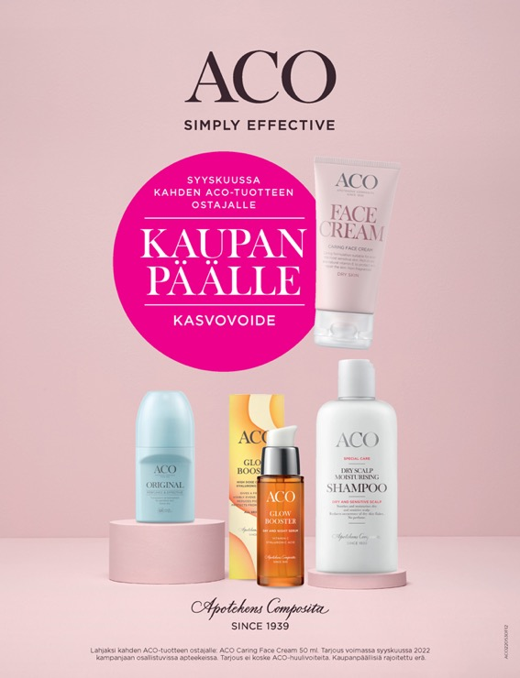
Avainapteekit
Average
64%
70%
said that the ad was
clear and understandable.
37%
rated the ad as the best
“The ad is clear and understandable”,
average of studied ads 62%.

Slide 79
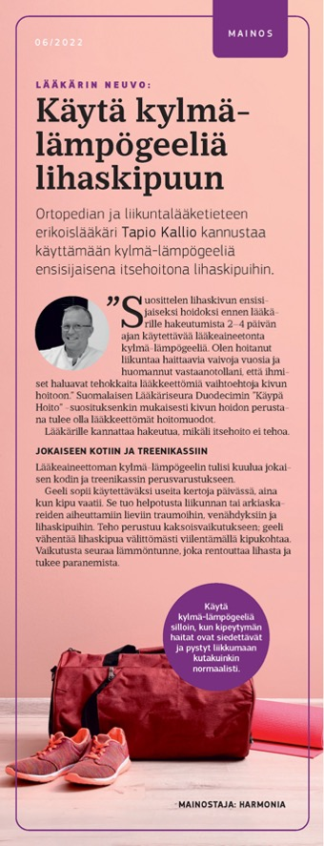
Avainapteekit
Noting score
36%
The noting score is often lower for half-page ads compared to larger ads.
An advertorial with a good headline might still interest readers who feel that
the topic is important.
63%
of readers who noticed the ad looked at it more carefully.
37%
rated the ad as the best
“I looked at the ad more carefully”,
average of studied ads 30%.

Slide 80
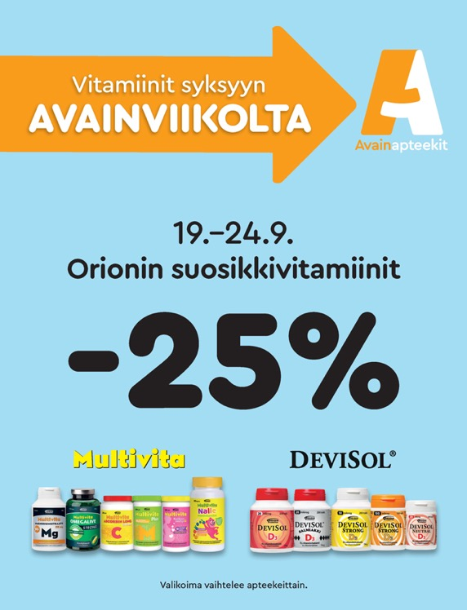
Avainapteekit
Noting score
61%
84%
said that the ad was clear and understandable.
“The ad is clear and understandable”,
average of studied ads 62%.

Slide 81
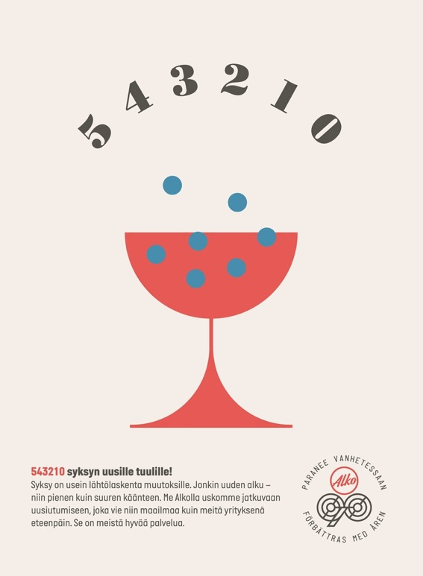
Etiketti
Noting score
59% (back cover)
An ad on the back cover is usually noticed slightly better than ads elsewhere in the magazine.
43%
of the people who noticed the ad said that the ad stands out from the magazine’s other content
37%
rated the ad as the best
“The ad stands out and catches your attention among the magazine’s other content”, average of studied ads 25%.

Slide 82

Sisustamo
Noting score
54%
31%
rated this ad as the best
37%
rated the ad as the best
The average noting score of the studied ads 49%.

Slide 83


Noting score
49%
Noting score
33%
Sisustamo
71%
said that the ad looked good. This was the best result for all studied ads.
37%
rated the ad as the best
68%
said that the ad gave them a positive image of the advertiser.
“The ad looks good”,
average of studied ads 34%.
“The ad gives a positive image of the advertiser”,
average of studied ads 43%.

Slide 84
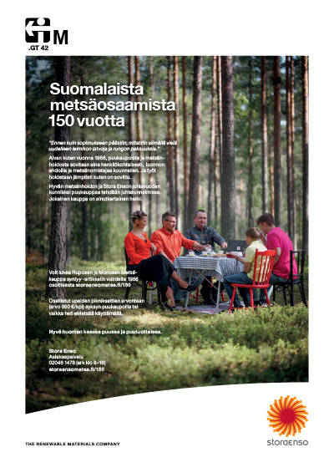
Terve Metsä
Noting score
62% (back cover)
The company’s own ads are often just as effective or more effective than ads from outside advertisers.
50%
said that the ad was clear and understandable.
37%
rated the ad as the best
The average noting score of the studied ads 49%.

Slide 85

Uniikki
Noting score
65% (inner front cover)
This was also the company’s own ad.
76%
said that the ad was clear and understandable.
37%
rated the ad as the best
“The ad is clear and understandable”,
average of studied ads 62%.

Slide 86

Uniikki
Noting score
28%
51%
said that the ad gave them new information. Among the studied ads, L’Oréal’s advertorial was the best by far in this regard.
25%
said that the ad appealed to their emotions. This was also the best result among all ads.
“The ad provides new information”,
average of studied ads 17%.
“The ad appeals to emotions”,
average of studied ads 9%.

Slide 87
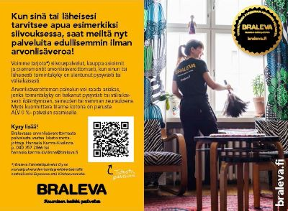
Vinkkari
Noting score
52% (back cover)
33%
rated the ad as the best
73%
said that Braleva’s own ad was clear and understandable.
37%
rated the ad as the best
“The ad is clear and understandable”,
average of studied ads 62%.

Slide 88

Vinkkari
Noting score
41%
Respondents liked the ad, because it provided new information.
“Makes it clear what you are getting a quote on.”
57%
of readers who noticed the ad looked at it more carefully.
37%
rated the ad as the best
“I looked at the ad more carefully”,
average of studied ads 30%.

Slide 89
Advertising summary
The average noting score for ads was 49%. Attention increases with ad size.
Of the people who noticed an ad, 30% read it more carefully, while 60% viewed and read it partially.
The ads received positive feedback on clarity and understandability (62%). The weakest feature was appeal to emotions (8%).
Ads increase the consideration of purchase (49%).
Several of the most notable ads were the publisher’s own ads.
Advertorials are often not the most noticed ads, but they may evoke emotions or offer valuable new information to those who notice them.

Slide 90
6.
Respondents’ background information

Slide 91
Respondents’ background information
% of respondents N = 4,992
Average
age
59
95% participate in daily purchasing decisions of their household economy
45% live in big cities
51% have a higher education

Slide 92
Respondents’ background information
% of respondents N = 4,992
25% of respondents had a gross income above EUR 75,000
(If those who chose not to answer are removed, the proportion is 30%.)
72% live with one or more people

Slide 93
7.
Summary

Slide 94
Summary
Customer media reach two thirds of all Finns.
Most read customer media in print, which is also greatly appreciated.
A customer medium builds a company’s image and strengthens the customer relationship. 77% of respondents consider the magazine an important customer benefit.
Customer magazines are the only print magazine many get in their mailbox. This makes the magazine stand out.
The magazine allows people to read about many topics that they would otherwise not read about. For this reason, the magazine is also a good channel for communicating the company’s values and stances and talking about its operations.

Slide 95
Summary
People are interested in good journalism, but you should not be afraid of pure commercialism. Bringing up new products and offers is an important part of the reading experience for many readers.
People are quite happy with their customer magazine – on a school grading scale of 4–10, readers gave the magazines an average rating of 8.5.
95% of readers notice at least one ad in the magazine. The average noting score for ads was 49%.
The strongest feature of articles and ads was clarity and understandability.
The feature that needs the most improvement is evoking emotions – advertisers should particularly pay attention to it.

Slide 96
Thank you!
Outi Itävuo
Finnish Magazine Media Association
outi.itavuo@aikakausmedia.fi
Jukka Helske
JHelske Research
jukka.helske@gmail.com

