Slide 1
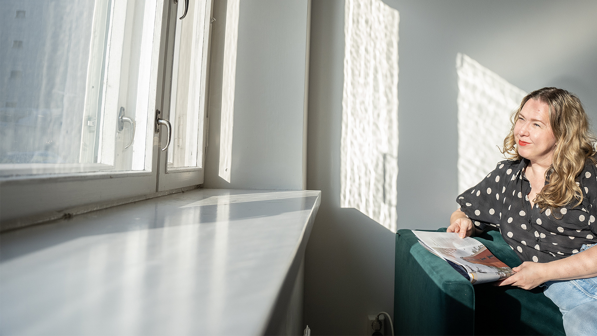

Reading times & number of readings of magazines
Finnish National Readership Survey (NRS) 2024

Slide 2
Contents
01
Reading times by magazine group
02
Number of readings by magazine group
03
Longest read magazines

Slide 3
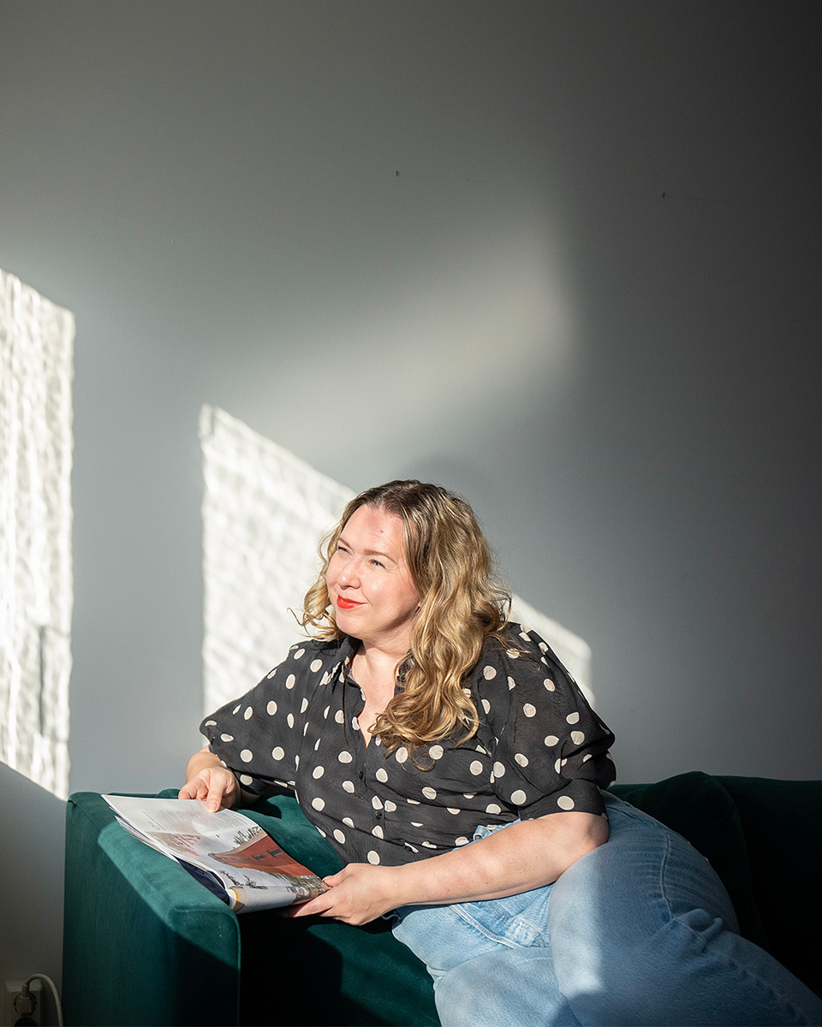
On Average, 52 minutes is spent reading a magazine issue.

Slide 4
Reading times by magazine group
Average amount of time spent on one issue, Averages by magazine group
Magazine group | Total 15+ population, Average reading times | Change from previous measurement (NRS 2023)
General interest magazines | 1 h 13 min | ± 0 min
Women's magazines | 1 h 4 min | – 3 min
Special interest magazines | 1 h 4 min | – 4 min
Motoring and technical magazines | 1 h 2 min | + 6 min
Health and well-being magazines | 60 min | – 6 min
Hobby magazines | 57 min | – 5 min
Travel magazines | 56 min | ± 0 min
Food and drink magazines | 56 min | + 2 min
Housing, construction and gardening magazines | 55 min | – 3 min
Economy and business magazines | 52 min | + 1 min
Professional magazines and organisation magazines | 46 min | – 2 min
Customer magazines | 37 min | ± 0 min
All magazines | 52 min | – 1 min

Slide 5
Reading times by magazine group
Average amount of time spent on one issue, Averages by magazine group
 | Women
General interest magazines | 1 h 15 min
Women's magazines | 1 h 9 min
Special interest magazines | 1 h 7 min
Health and well-being magazines | 1 h 6 min
Travel magazines | 60 min
Food and drink magazines | 60 min
Housing, construction and gardening magazines | 60 min
Hobby magazines | 57 min
Economy and business magazines | 52 min
Professional magazines and organisation magazines | 41 min
Customer magazines | 40 min
Motoring and technical magazines | 36 min
All magazines | 52 min
 | Men
General interest magazines | 1 h 9 min
Motoring and technical magazines | 1 h 6 min
Special interest magazines | 60 min
Hobby magazines | 57 min
Economy and business magazines | 52 min
Travel magazines | 49 min
Professional magazines and organisation magazines | 49 min
Food and drink magazines | 48 min
Housing, construction and gardening magazines | 44 min
Health and well-being magazines | 40 min
Women's magazines | 37 min
Consumer magazines | 30 min
All magazines | 49 min

Slide 6
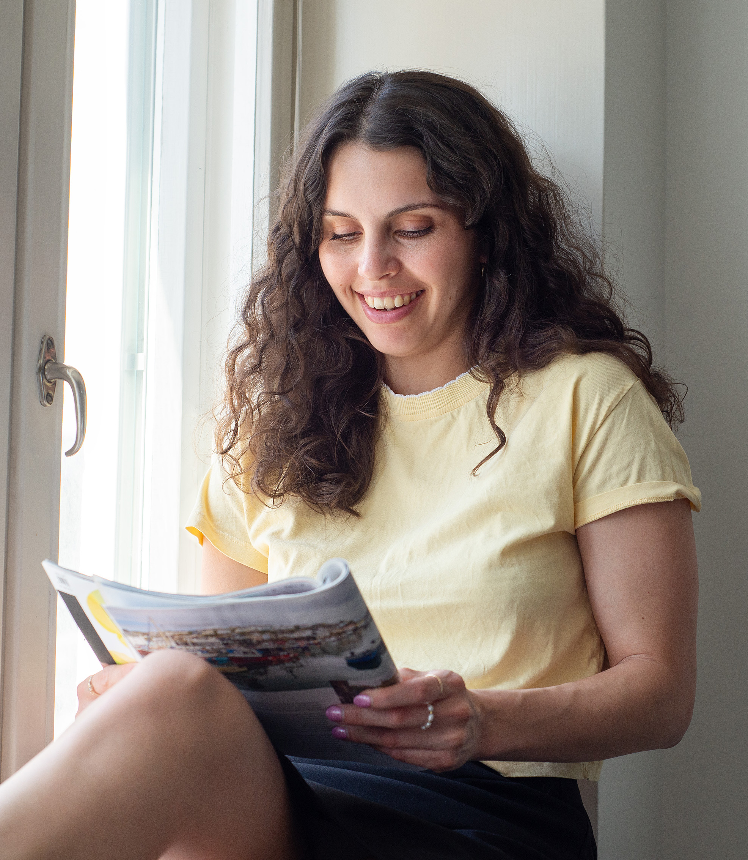

On Average, one issue of a magazine is taken 2 times
Housing, construction and gardening magazines (2,5 readings) and hobby magazines (2,4 readings) receive the highest number of readings.
There is no great variation in the number of readings of magazines in different magazine groups; even customer magazines that collect the least readings are viewed an Average of 1.5 times.

Slide 7
Number of readings by magazine group
Average number of readings per magazine issue, Average by magazine group
Magazine group | Total 15+ population, Average number of readings | Women, Average number of readings | Men, Average number of readings
Food and drink magazines | 2,5 | 2,8 | 2,1
Hobby magazines | 2,4 | 2,7 | 2,1
Travel magazines | 2,3 | 2,4 | 2,1
Special interest magazines | 2,2 | 2,3 | 2,2
General interest magazines | 2,2 | 2,2 | 2,2
Housing, construction and gardening magazines | 2,2 | 2,4 | 1,9
Motoring and technical magazines | 2,1 | 1,7 | 2,2
Women's magazines | 2,1 | 2,2 | 1,6
Health and well-being magazines | 2,0 | 2,1 | 1,7
Economy and business magazines | 1,9 | 1,9 | 2,0
Professional magazines and organisation magazines | 1,8 | 1,5 | 1,9
Customer magazines | 1,6 | 1,6 | 1,4
All magazines | 2,0 | 2,0 | 1,9

Slide 8
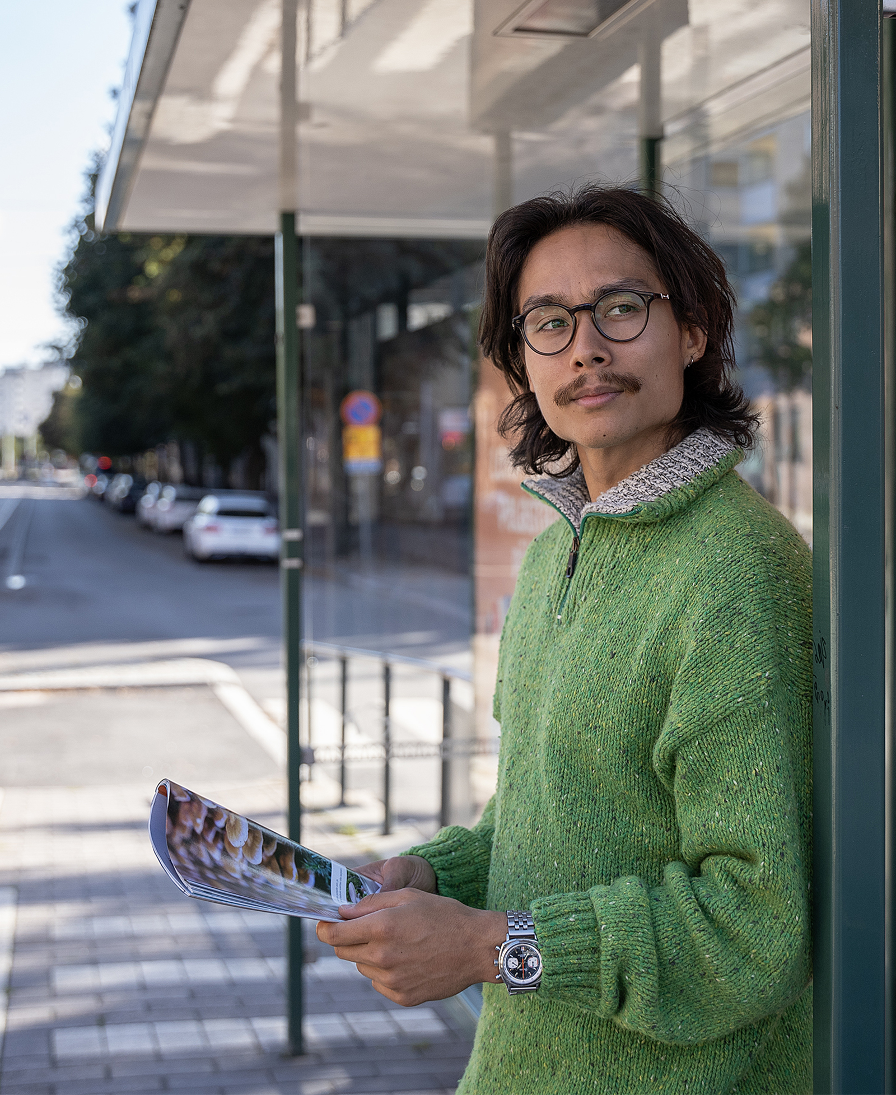
The magazines read the longest are enjoyed for over an hour.
Suomen Kuvalehti is the magazine with the longest reading time (1 h 35 min).

Slide 9
Longest read magazines, total
Average time spent on one issue
Magazine | Average reading time, total 15+ population
Suomen Kuvalehti | 1 h 35 min
Tiede | 1 h 19 min
Viva | 1 h 19 min
ET | 1 h 17 min
Apu | 1 h 16 min
Eeva | 1 h 16 min
Mobilisti | 1 h 15 min
Tiede Luonto | 1 h 14 min
Antiikki & Design | 1 h 13 min
Seura | 1 h 12 min
All magazines | 52 min
Magazine | Average reading time, Women
Suomen Kuvalehti | 1 h 31 min
Antiikki & Design | 1 h 26 min
Tiede | 1 h 24 min
ET | 1 h 23 min
Viva | 1 h 23 min
Apu | 1 h 21 min
Tiede Luonto | 1 h 20 min
Eeva | 1 h 20 min
Suomen Luonto | 1 h 17 min
Kotiliesi | 1 h 15 min
All magazines | 52 min
Magazine | Average reading time, Men
Suomen Kuvalehti | 1 h 38 min
Mobilisti | 1 h 19 min
Tekniikan Maailma | 1 h 16 min
Tiede | 1 h 16 min
Auto Bild Suomi | 1 h 13 min
Seura | 1 h 11 min
Apu | 1 h 9 min
Mikrobitti | 1 h 7 min
Tiede Luonto | 1 h 7 min
IS Urheilulehti | 1 h 7 min
All magazines | 49 min

Slide 10
Longest read magazines by magazine group
Average time spent on one issue
Professional magazines and organisation magazines | Average reading time
Käytännön Maamies | 57 min
Tivi | 56 min
Koneviesti | 52 min
Metsälehti | 50 min
Aarre | 47 min
Maatilan Pellervo | 45 min
Reserviläinen | 44 min
Ruotuväki | 39 min
Opettaja | 36 min
All professional and organisation magazines | 46 min
Customer magazines | Average reading time
Pirkka | 39 min
Samarbete | 39 min
Yhteishyvä | 38 min
Terveydeksi! | 32 min
Avainapteekit | 30 min
All customer magazines | 37 min
Housing, construction and gardening magazines | Average reading time
Antiikki & Design | 1 h 13 min
Kotipuutarha | 1 h 6 min
Viherpiha | 1 h 6 min
Maalla | 60 min
Koti ja Keittiö | 55 min
Meidän Mökki | 53 min
Avotakka | 52 min
Unelmien Talo & Koti | 52 min
Meidän Talo | 49 min
Glorian Koti | 48 min
All housing, construction and gardening magazines | 58 min

Slide 11
Longest read magazines by magazine group
Average time spent on one issue
Motoring and technical magazines | Average reading time
Mobilisti | 1 h 12 min
Tekniikan Maailma | 1 h 9 min
Auto Bild Suomi | 1 h 4 min
Tuulilasi | 1 h 3 min
Moottori | 59 min
Vauhdin Maailma | 58 min
All motoring and technical magazines | 62 min
Special interest magazines | Average reading time,
Tiede | 1 h 19 min
Tiede Luonto | 1 h 14 min
Suomen Luonto | 1 h 10 min
Askel | 1 h 7 min
IS Urheilulehti | 1 h 3 min
Kotimaa | 1 h 2 min
Aku Ankka | 41 min
All special interest magazines | 64 min
Hobby magazines | Average reading time
Suuri Käsityö | 1 h 7 min
Mikrobitti | 1 h 2 min
Caravan | 1 h 2 min
Kotiliesi Käsityö | 58 min
Vene | 58 min
Juoksija-lehti | 56 min
Metsästys ja Kalastus | 54 min
Erä | 53 min
Ihana | 52 min
Golflehti | 51 min
All hobby magazines | 57 min

Slide 12
Longest read magazines by magazine group
Average time spent on one issue
Travel magazines | Average reading time
Mondo | 59 min
Matka | 54 min
All travel magazines | 56 min
Women's magazines | Average reading time
Eeva | 1 h 16 min
Kotiliesi | 1 h 10 min
Kodin Kuvalehti | 1 h 6 min
Kodin Pellervo | 1 h 2 min
Me Women | 58 min
Anna | 58 min
Kotivinkki | 53 min
Gloria | 48 min
All women's magazines | 1 h 4 min
Food and drink magazines | Average reading time
Glorian ruoka&viini | 58 min
Viinilehti | 56 min
Maku | 53 min
All food and drink magazines | 56 min

Slide 13
Longest read magazines by magazine group
Average time spent on one issue
Economy and business magazines | Average reading time
Arvopaperi | 57 min
Talouselämä | 54 min
Taloustaito | 53 min
Viisas Raha | 53 min
Tekniikka&Talous | 41 min
All economy and business magazines | 52 min
Health and well-being magazines | Average reading time
Hyvä Terveys | 1 h 4 min
ET Terveys | 60 min
Apu Terveys | 60 min
Voi Hyvin | 59 min
Kauneus & Terveys | 54 min
All health and well-being magazines | 60 min
General interest magazines | Average reading time
Suomen Kuvalehti | 1 h 35 min
Viva | 1 h 19 min
ET | 1 h 17 min
Apu | 1 h 16 min
Seura | 1 h 12 min
Alibi | 60 min
Hymy | 50 min
Seiska | 47 min
Katso | 47 min
All general interest magazines | 70 min

Slide 14
The Finnish National Readership Survey (NRS) figures for individual magazines can be obtained without registration from Magazine Rate Card service:
www.ratecards.fi
More summaries from the NRS in
Finnish Magazine Media Association’s website:
www.aikakausmedia.fi/en/research

Slide 15
Aikakausmedia.fi/en │ Ratecards.fi

